Slide 1
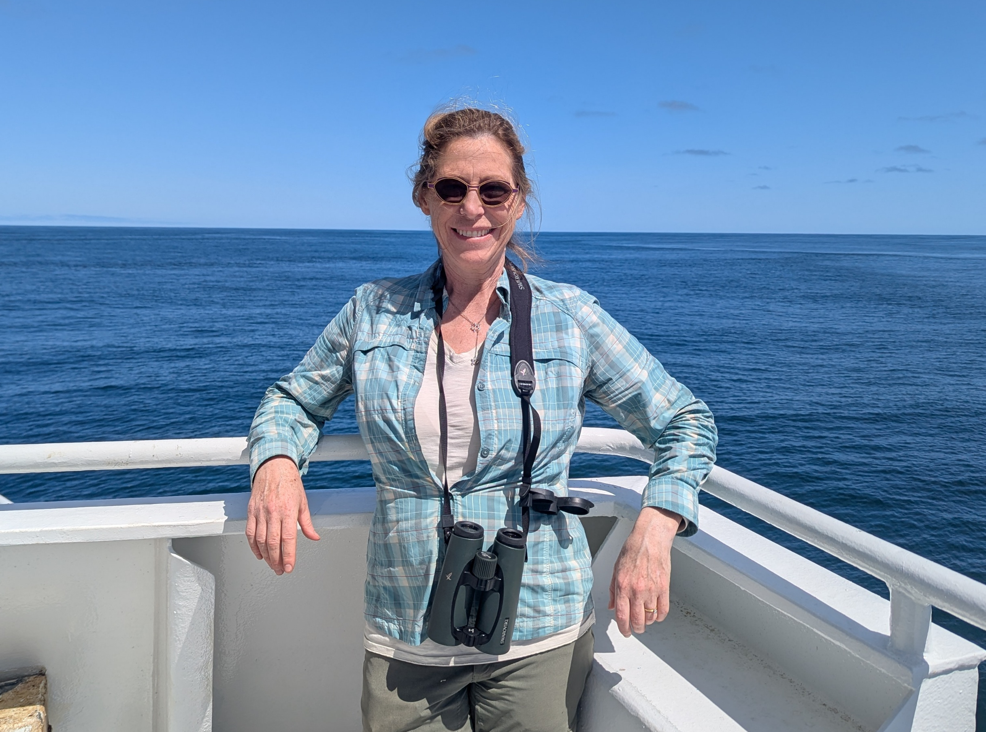
Integrating US and CAN marine data to identify region-specific limiting factors across a transboundary salmon migration
Lisa Crozier, Cameron Freshwater,
Brian Burke, David Huff, Eric Ward, Doug Jackson and EVE Pugsley
PICES Annual Meeting 2026
Topic Session S12: Transboundary Science for a Changing North Pacific Ocean
Nanaimo, Canada
Oct 29, 2026

Slide 2
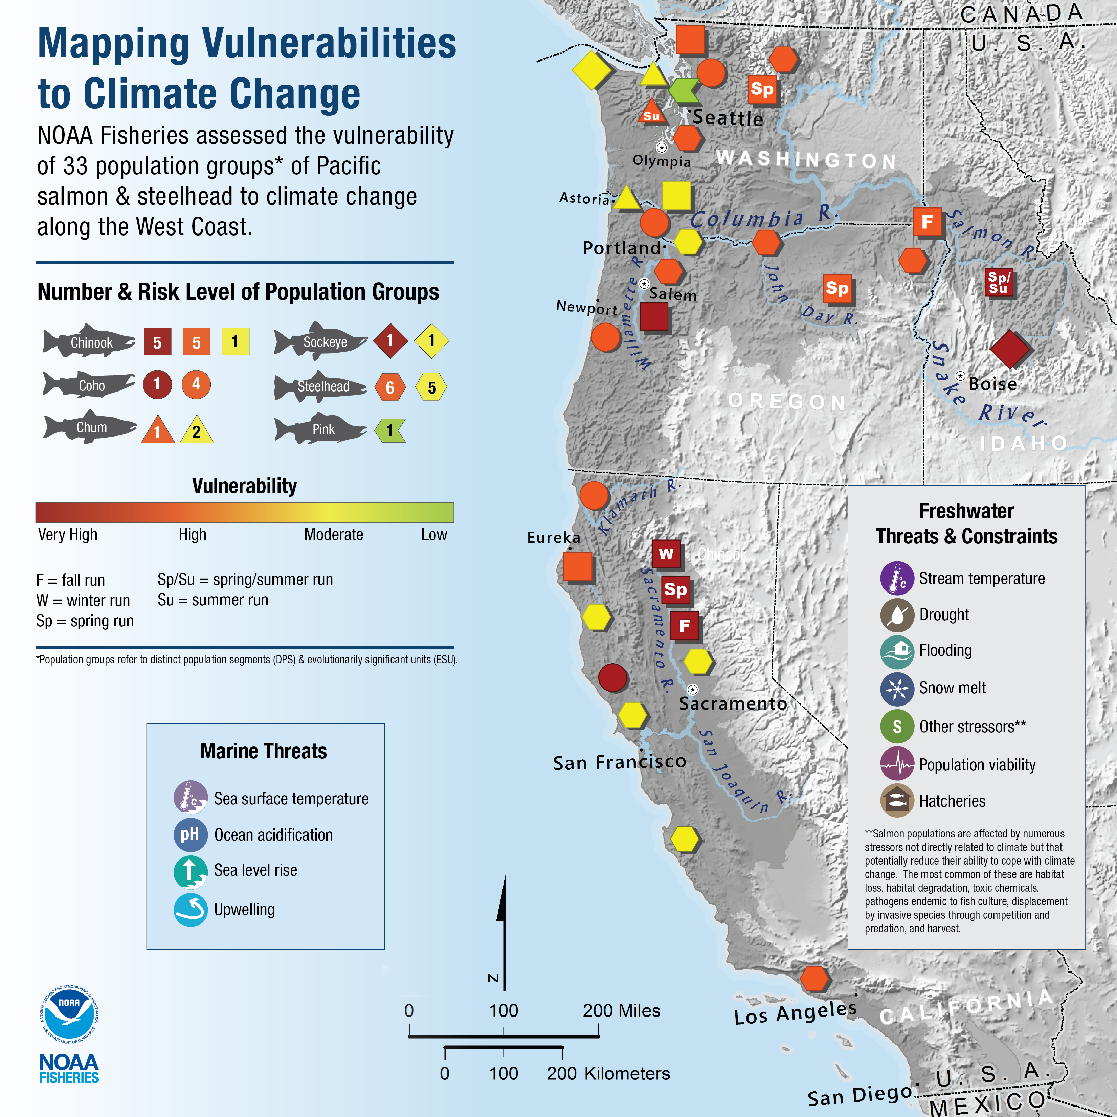
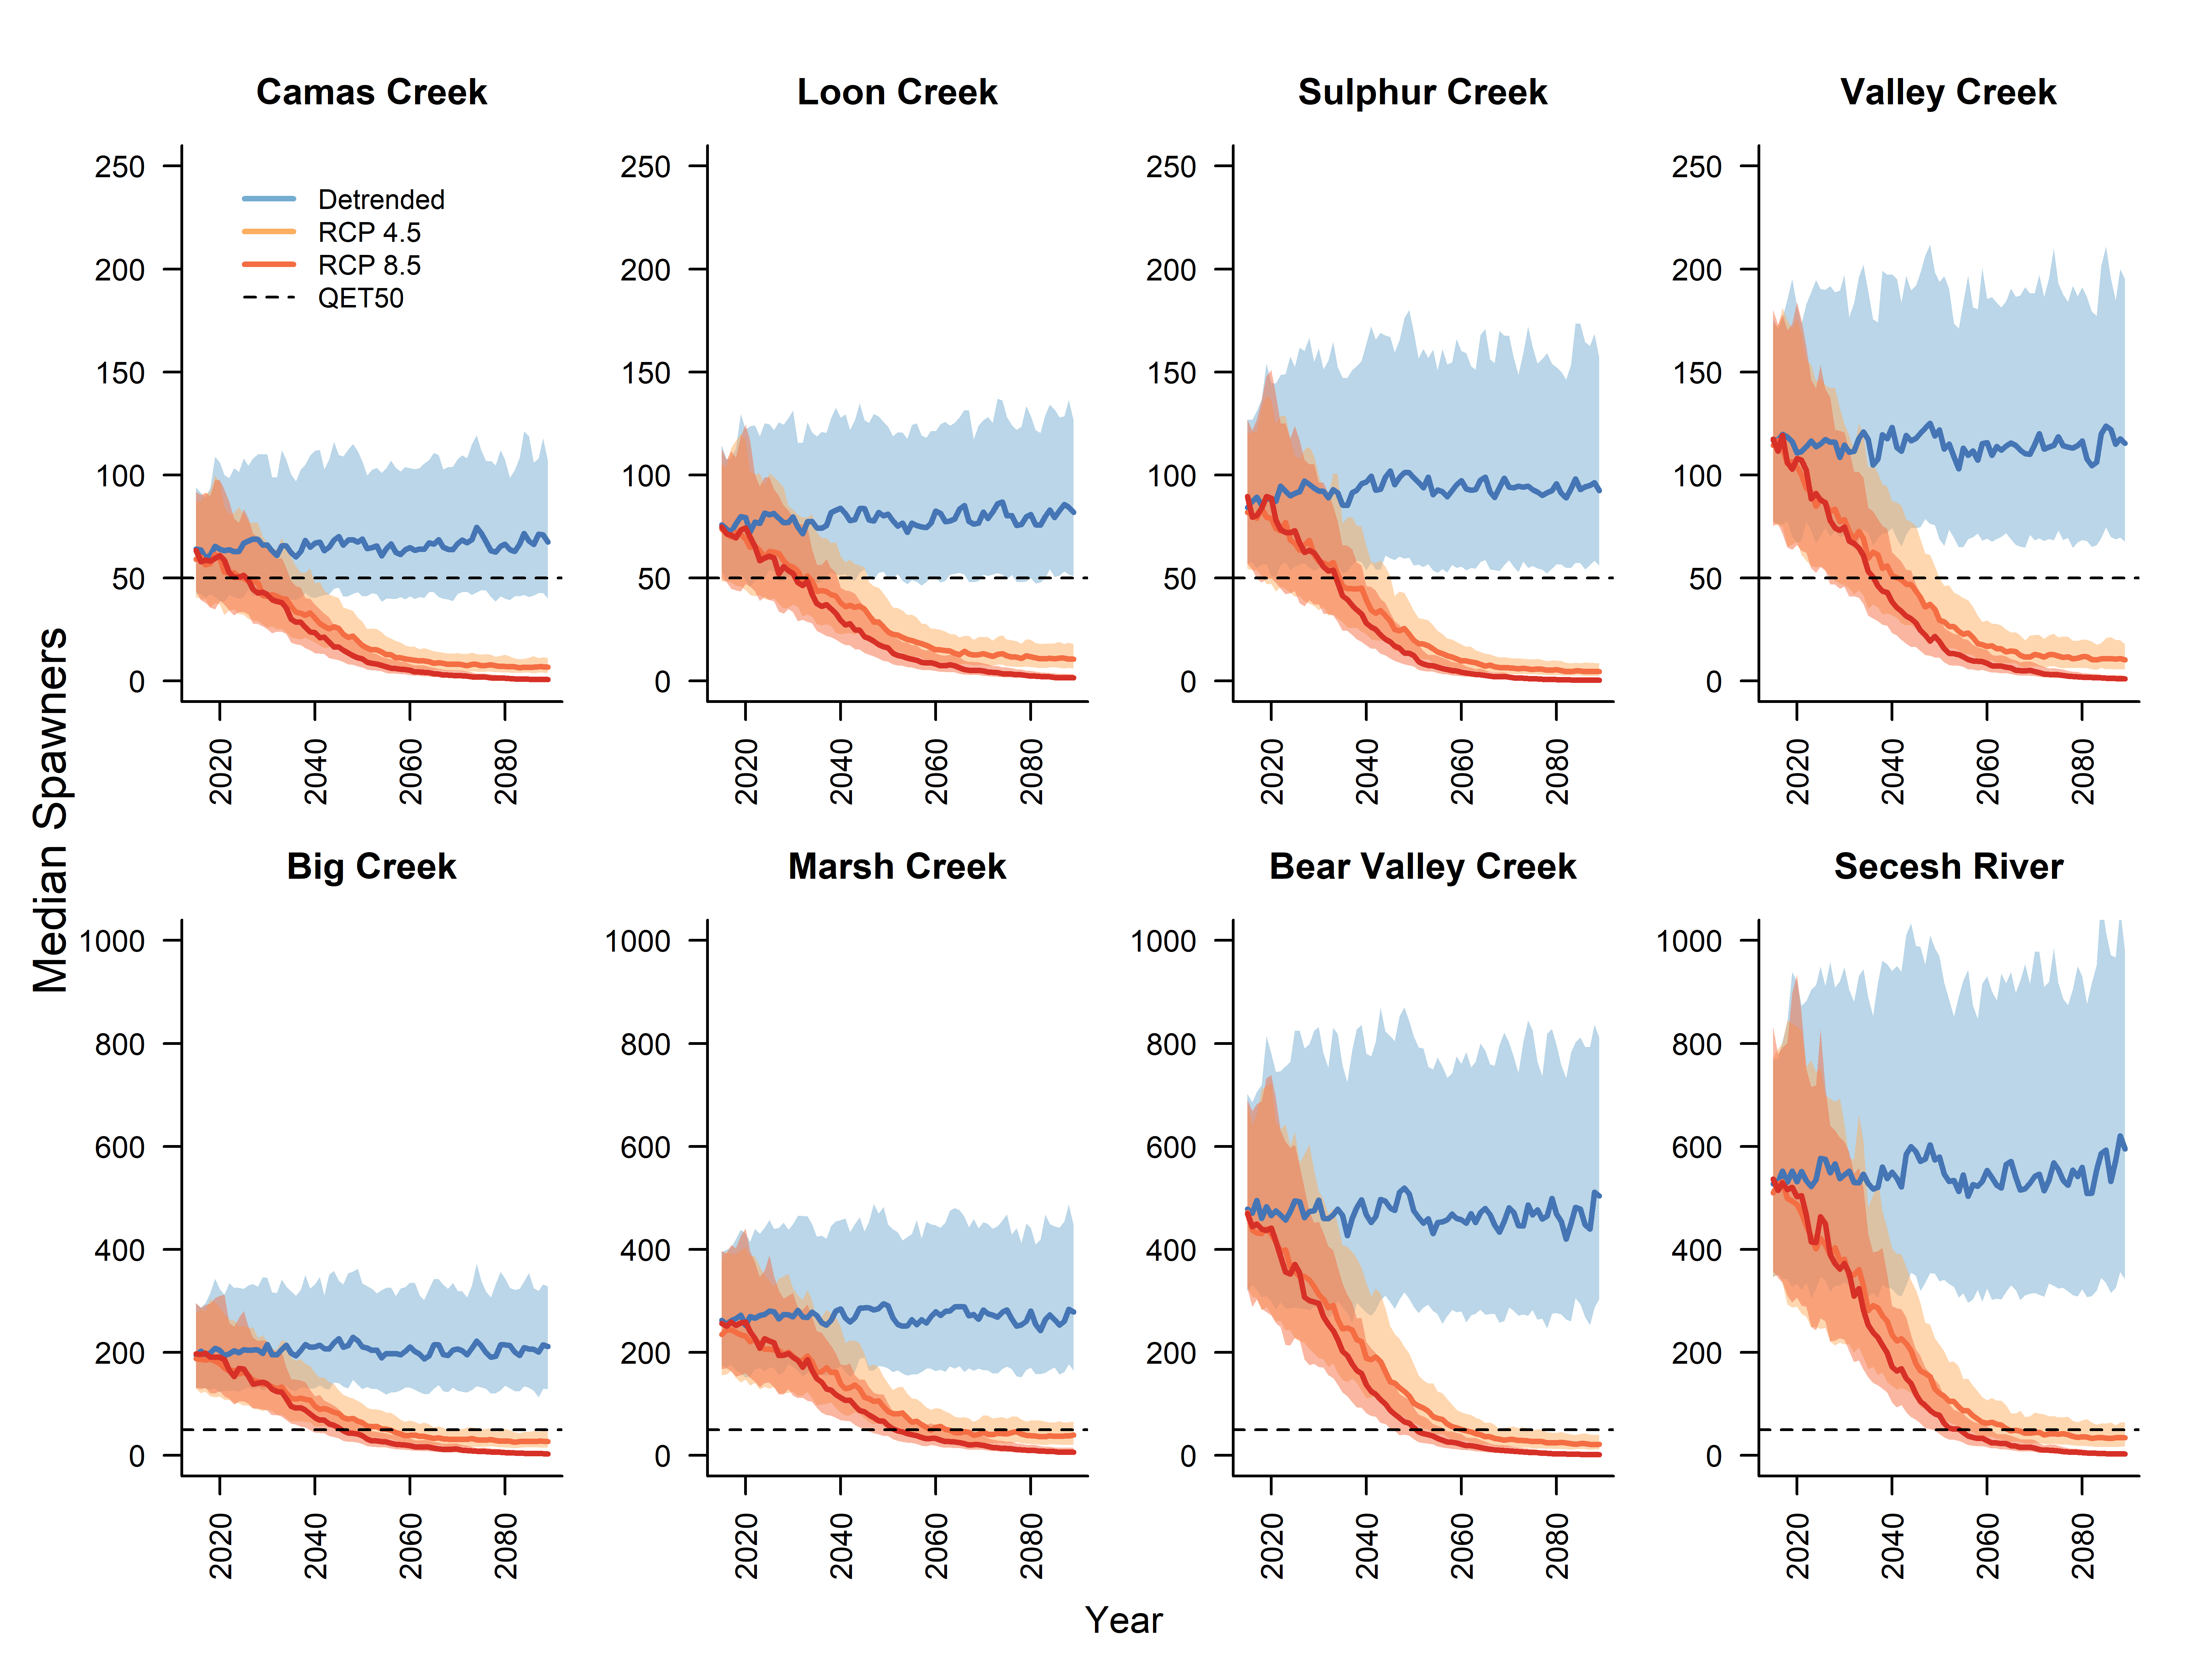
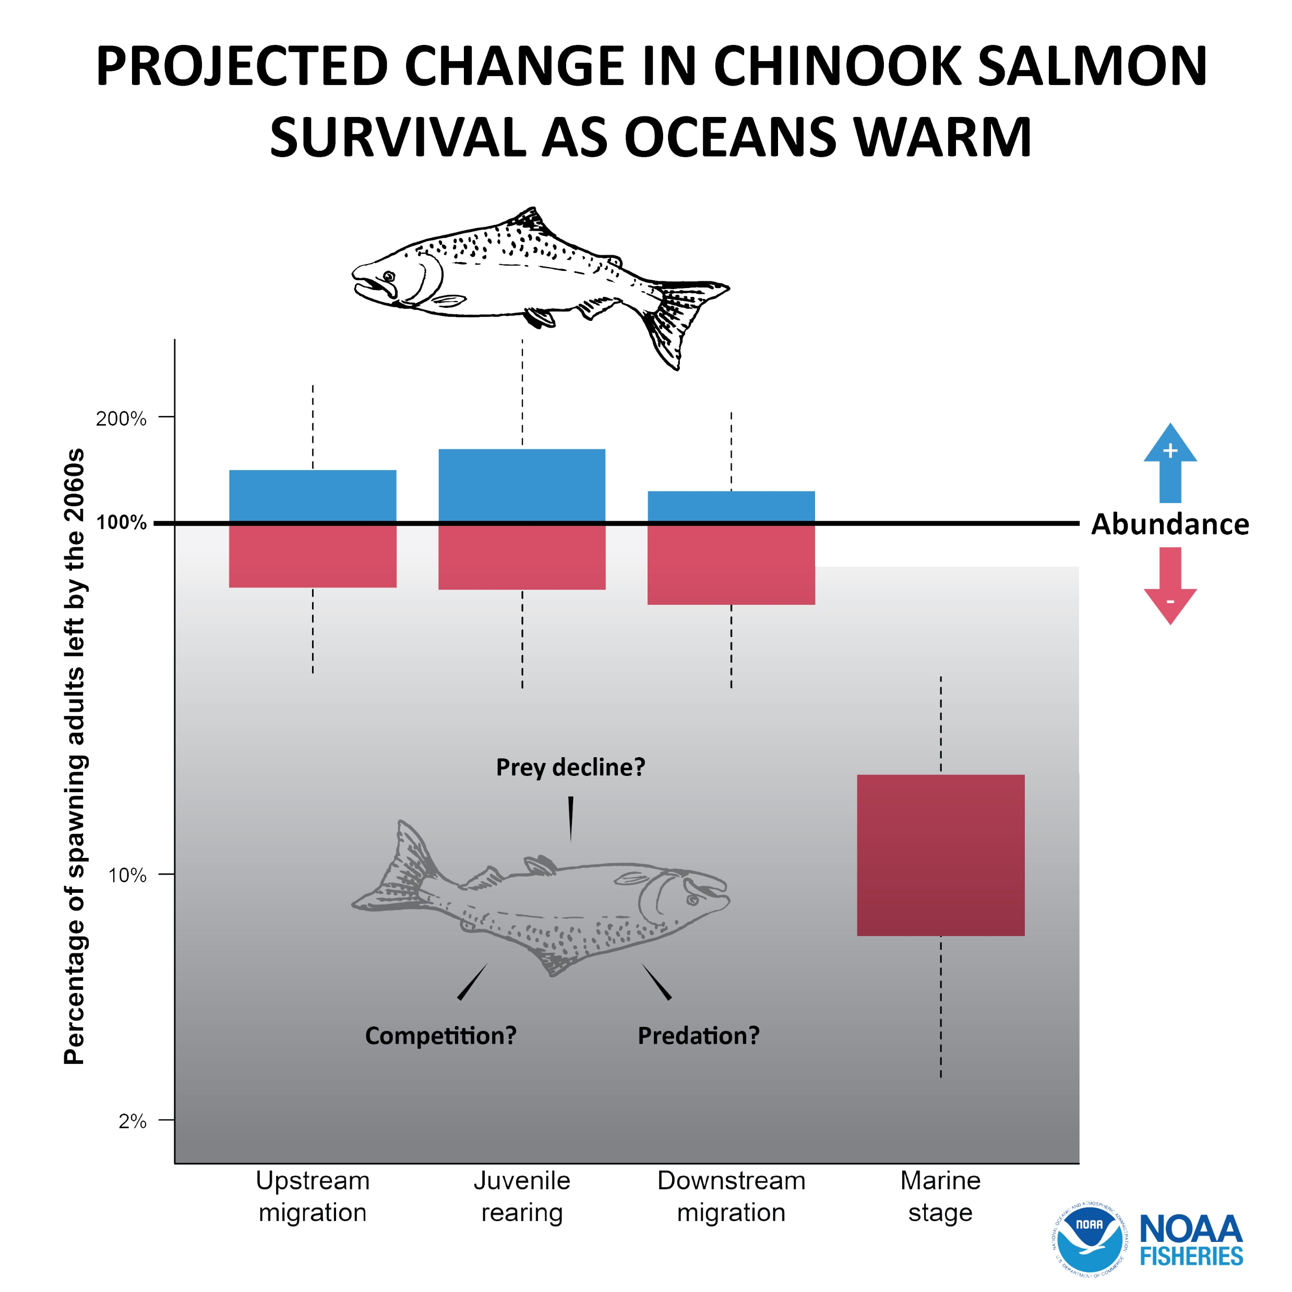
Many species were already endangered, and climate change compounds threat – particularly the marine stage of spring Chinook salmon
Crozier, et al (2021) https://doi.org/210.1038/s42003-42021-01734-w

Slide 3
Maybe show Jenn’s pretty picture of teleconnections?

Slide 4
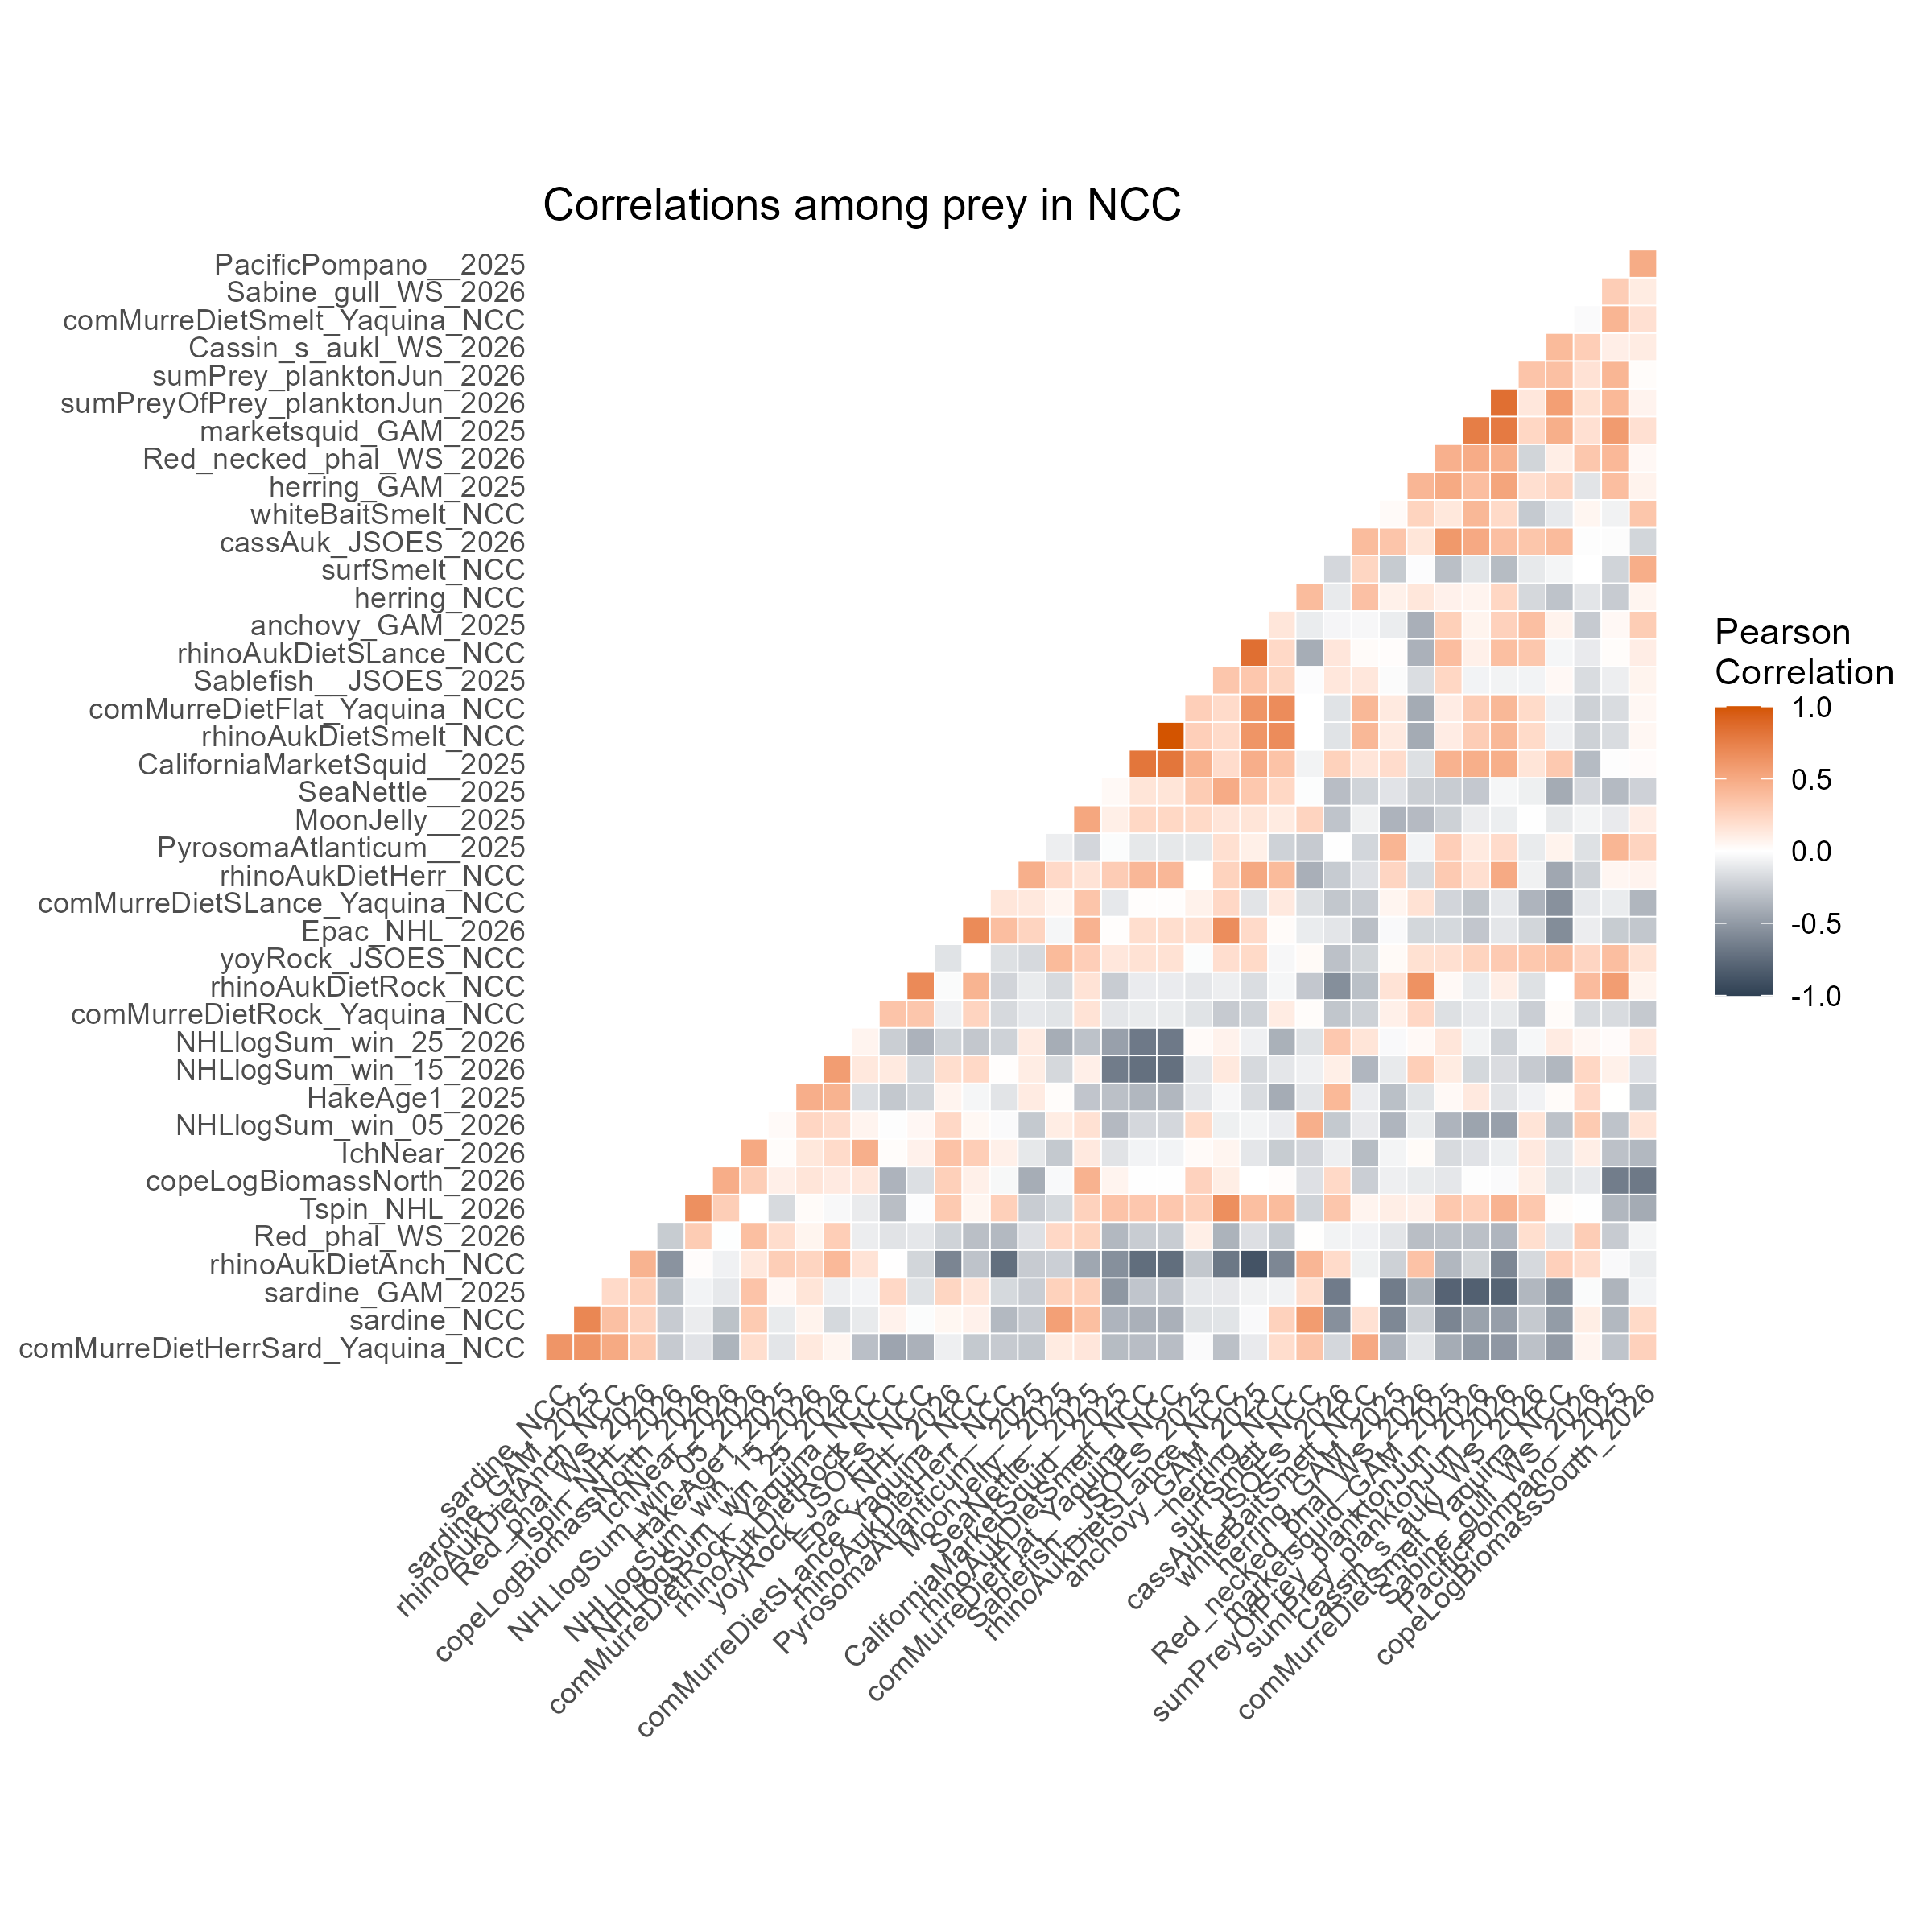
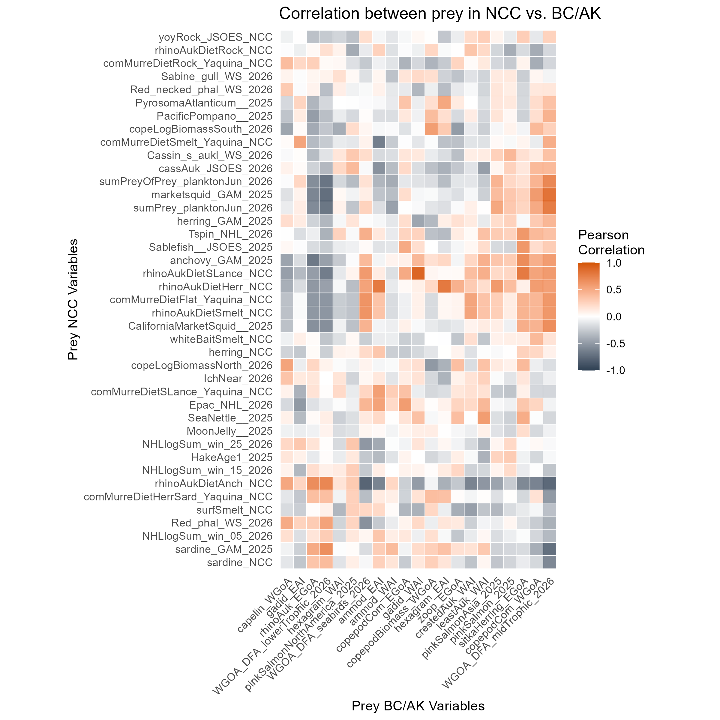
Strong correlations within and between regions

Slide 5
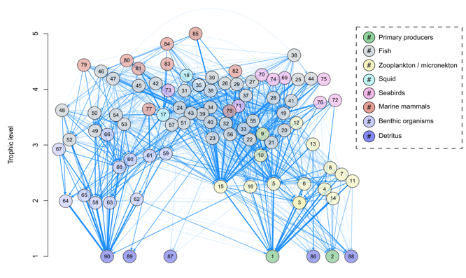
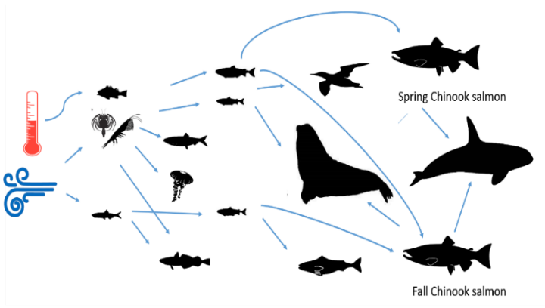
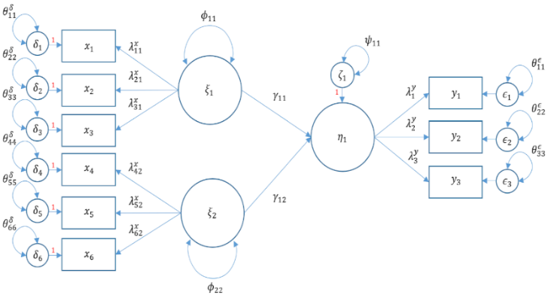
Structural equation model approach
More realistic food web -- Lots of species eat many interacting prey
Try to reduce the list to the most important ones
SEM:
Latent variables ~ sets of correlated species
Path model ~ tests alternative hypothesized relationships amid covariance

Slide 6
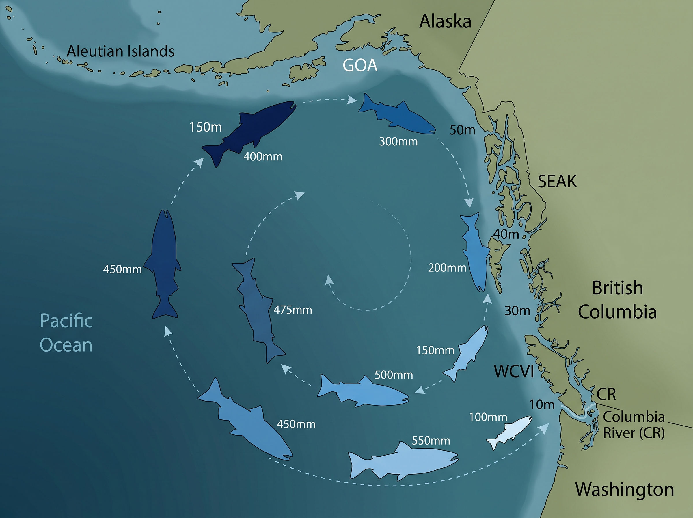
NOT READY

Slide 7
Goals
Identify viable models to reduce the number of candidate indices
Test hypotheses:
  Bigger is better (bottom-up regulation)
  Predator abundance is driving salmon survival (top-down regulation)
  Predator impact is modulated by conditions (top-down modulated)

Slide 8
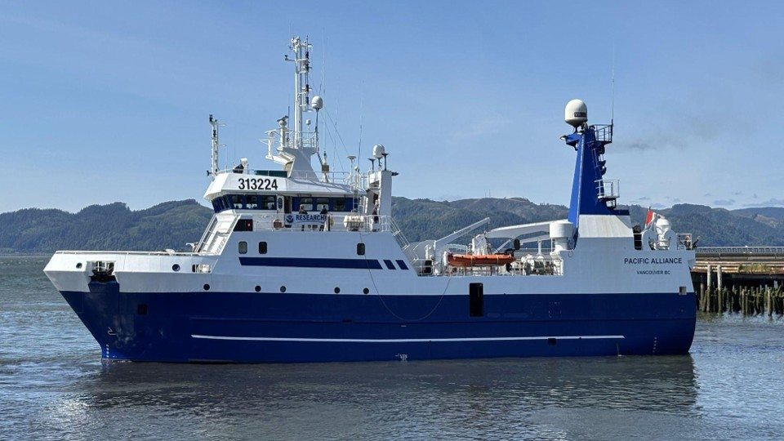
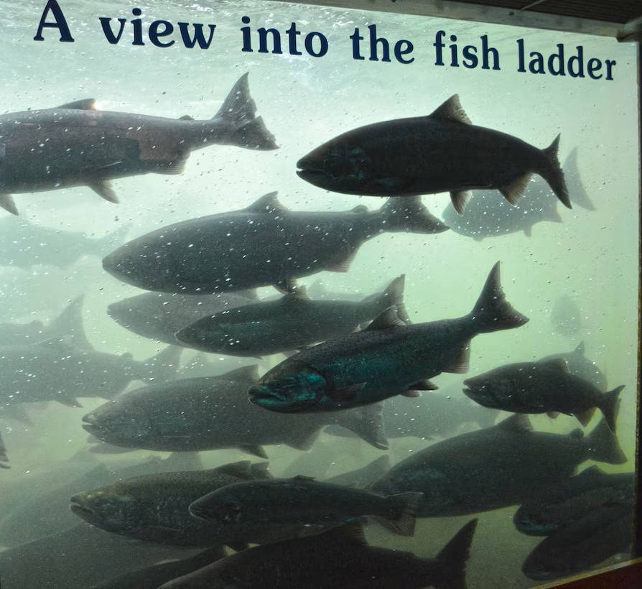
Model structure
H1
Early marine stage:
<June smolt mig yr
Data from
JSOES survey
Marine Growth Rate
(IGF + stomach fullness
or fork length)
PreyNCC
PredatorsNCC
Early Marine Survival
(cpue June JSOES survey +
sdmTMB modeled abundance)
JSOES survey 2025
Smolt to Adult Return
(BON-BON, pittagged SR+UC)
Late marine stage:
>June smolt mig yr
Data from
BC/AK surveys
Columbia River mammals
PreyAK
PredatorsAK
Photo: usace.army.mil
Notes:
Our ultimate goal is to predict SAR from biological indices rather than climatic indices. And we want to do that by partitioning total marine survival into early and later stages.
All components of the model are smoothed using either a DFA to combine potential latent variables or a MARSS model for single variables. This is part of the “fair test” requirement for this phase
We tested this hypothesis by comparing two model structures.
In the first, a number of different possible indices of growth were modeled as predictors of early marine survival, measured using both the cpue directly from the JSOES survey as well as a modeled abundance from a spatiotemporal model that accounts for slight variations from year to year in the survey
Our response variable is the combined SAR
Here are 2 structures we explored – growth -> abundance -> SAR
Growth->SAR & Abund -> SAR
The idea was to compare model structures by aic
But also to identify the best predictors a
Size to cpue
Size selective predation, gape-limited predation
Prey-switching of predator – predators eating more other prey (buffer)

Slide 9
Model structure
H1
H2
Early marine stage:
<June smolt mig yr
Data from
JSOES survey
Early Growth
PreyNCC
PreyNCC
PredatorsNCC
Early Growth
Early Survival
PredatorsNCC
Early Marine Survival
Smolt to Adult Return
Smolt to Adult Return
Late marine stage:
>June smolt mig yr
Data from
BC/AK surveys
Columbia River mammals
PreyAK
PreyAK
PredatorsAK
PredatorsAK
Photo: usace.army.mil
Notes:
Our ultimate goal is to predict SAR from biological indices rather than climatic indices. And we want to do that by partitioning total marine survival into early and later stages.
All components of the model are smoothed using either a DFA to combine potential latent variables or a MARSS model for single variables. This is part of the “fair test” requirement for this phase
We tested this hypothesis by comparing two model structures.
In the first, a number of different possible indices of growth were modeled as predictors of early marine survival, measured using both the cpue directly from the JSOES survey as well as a modeled abundance from a spatiotemporal model that accounts for slight variations from year to year in the survey
Our response variable is the combined SAR
Here are 2 structures we explored – growth -> abundance -> SAR
Growth->SAR & Abund -> SAR
The idea was to compare model structures by aic
But also to identify the best predictors a
Size to cpue
Size selective predation, gape-limited predation
Prey-switching of predator – predators eating more other prey (buffer)

Slide 10
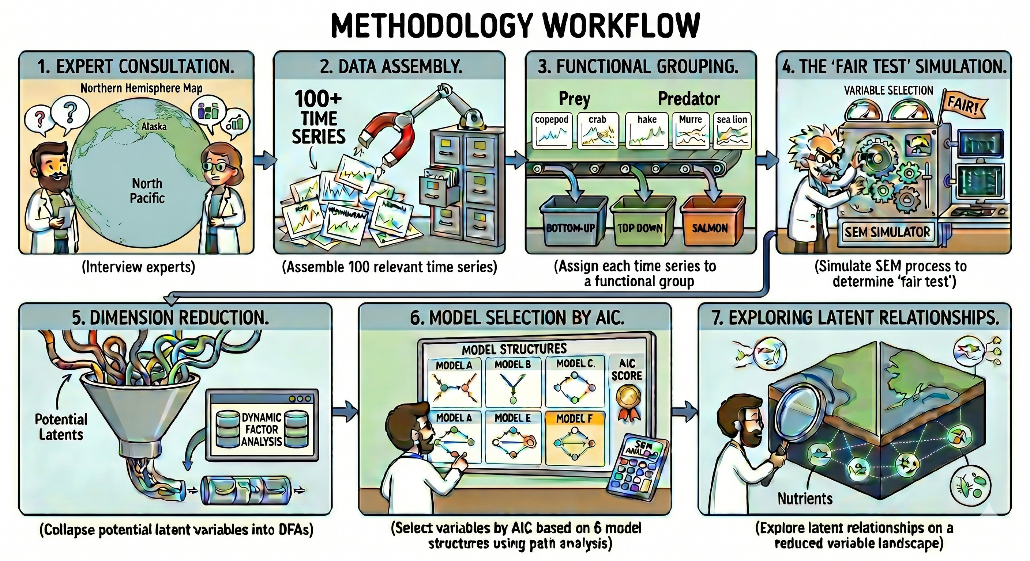
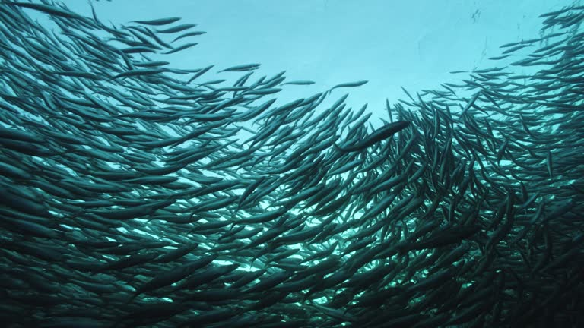
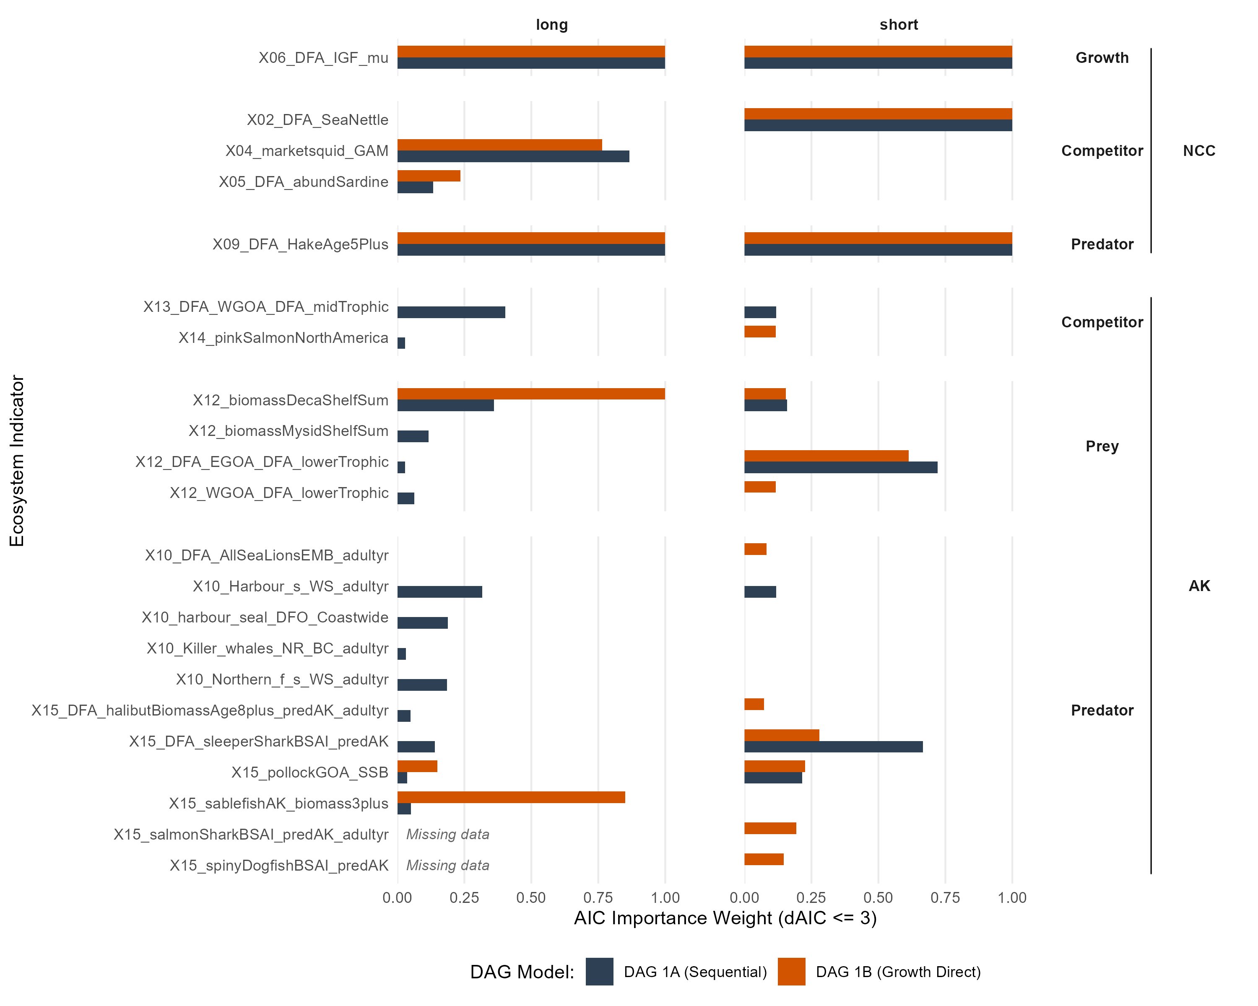


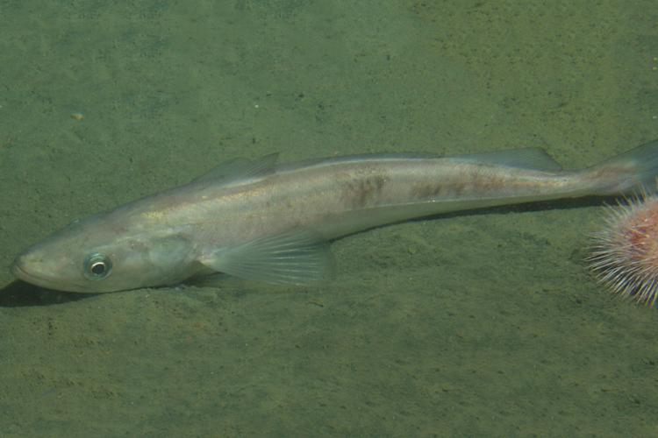



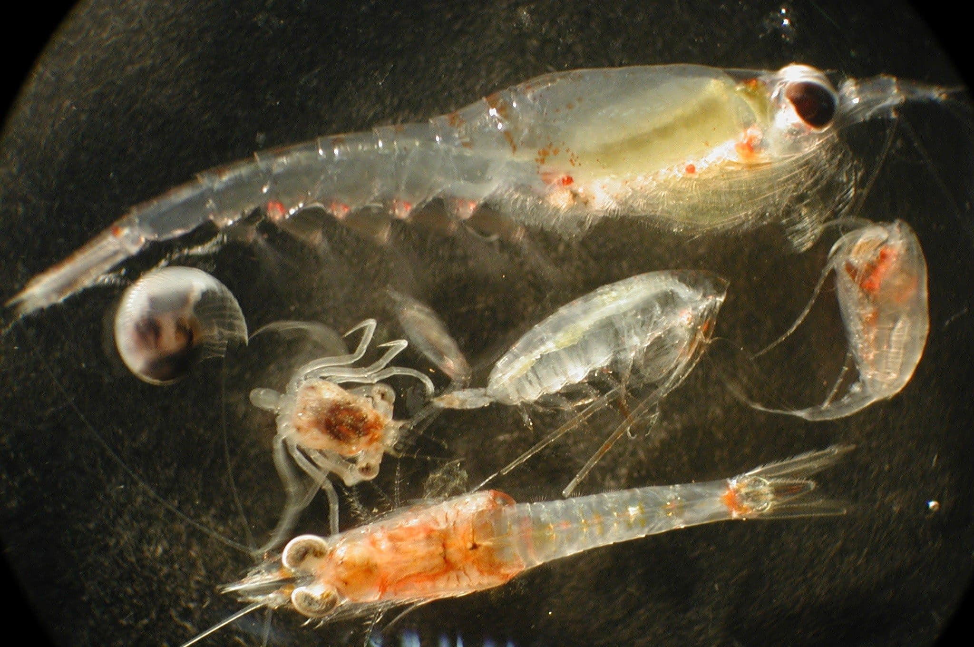

<10 indicators had very strong predictive power
Winners within each SEM node:
Prey NCC:
Forage fish DFA
JSOES plankton
Predators NCC:
Hake and mackerel DFA
Common murre (proxy)
Prey AK:
Zooplankton prey (amphipods, euphausiids, decapods) and success of plankton-eating birds
Pred on Adults:
Mammals in and near the Columbia River were not consistent (proxy)
Getty images
Indicator
Photo: NOAA
Photo: NOAA

Slide 11
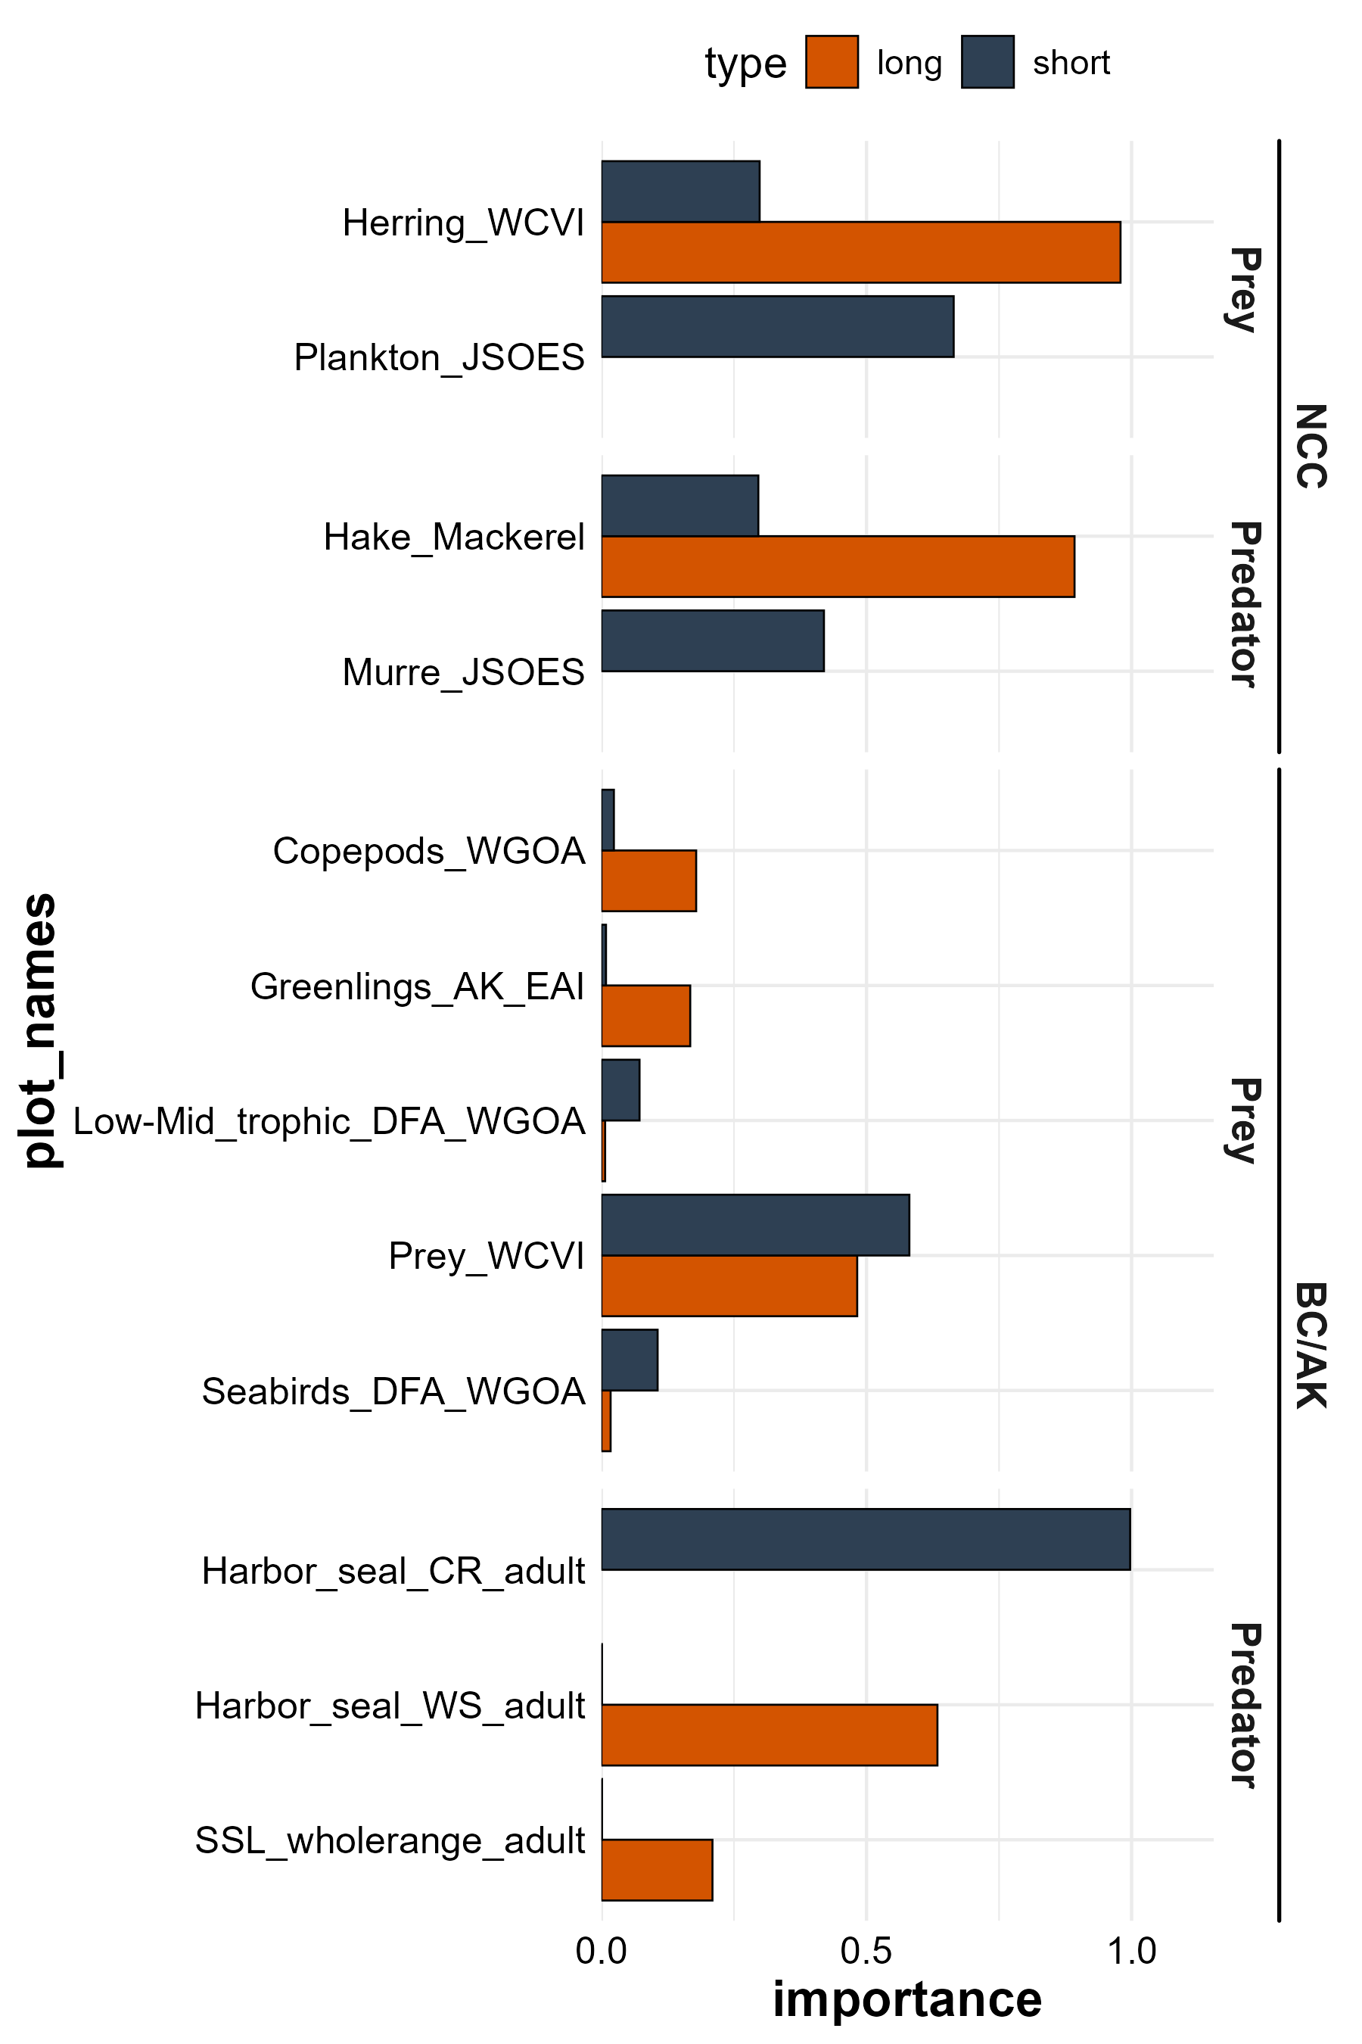
<10 indicators had very strong predictive power
Winners within each SEM node:
Prey NCC:
Forage fish DFA
JSOES plankton
Predators NCC:
Hake and mackerel DFA
Common murre (proxy)
Prey AK:
Zooplankton prey (amphipods, euphausiids, decapods) and success of plankton-eating birds
Pred on Adults:
Mammals in and near the Columbia River were not consistent (proxy)
Getty images
Indicator
Photo: NOAA
Photo: NOAA

Slide 12
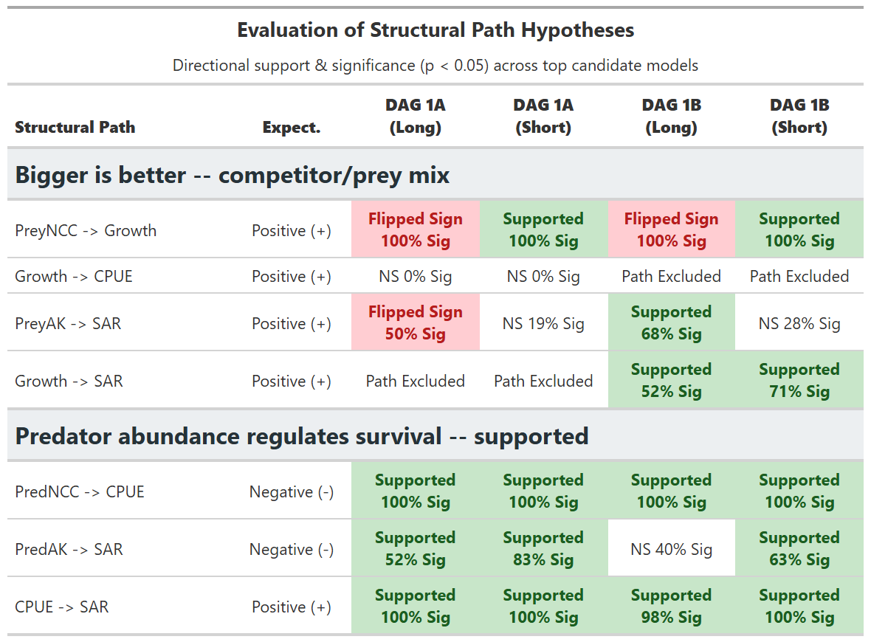
Hypotheses 1 & 2 mostly supported
Market squid, pink salmon and
WGOA midtrophic (forage fish)
(+ when I expected -)
Plankton +
Krill and lowertrophic -
Pollock and sablefish are +
Harbor seals and sharks are -

Slide 13
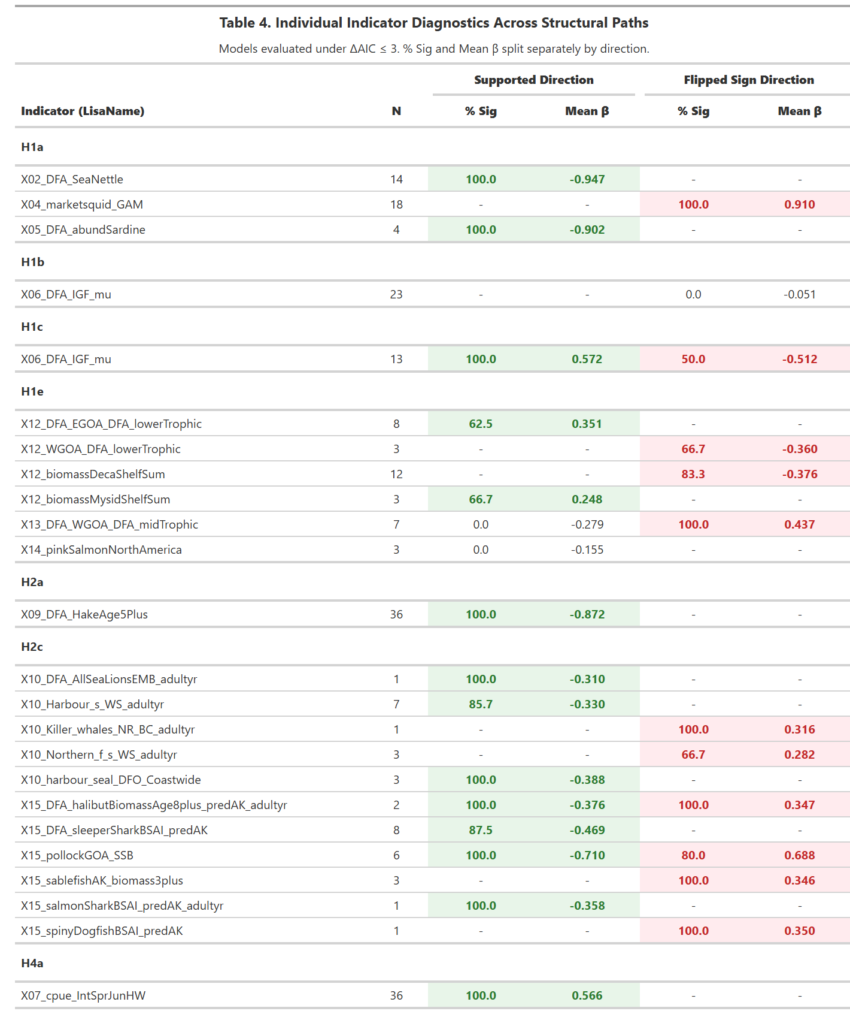
However, some indicators had the opposite impacts compared with those expected
“flipped sign”

Slide 14
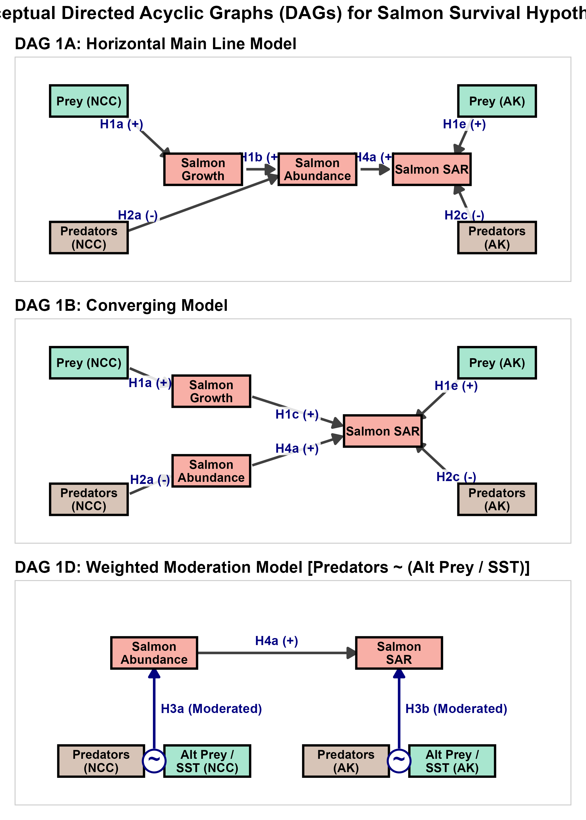
Hypothesis 3: Predator impact is modulated by the abundance of alternative prey and temperature-driven spatial overlap between predators and salmon (top-down modulated)

Slide 15
THERE WILL BE A “GOOD OCEAN” AND “BAD OCEAN” PANEL W/ PREDATORS OVERLAPPING MORE AND FEWER ALTERNATIVE PREY IN BAD OCEAN

Slide 16
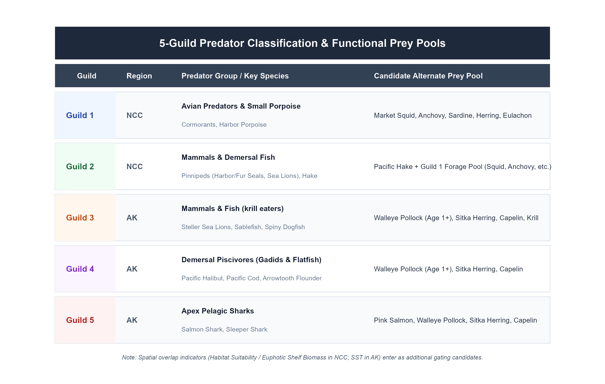

Slide 17
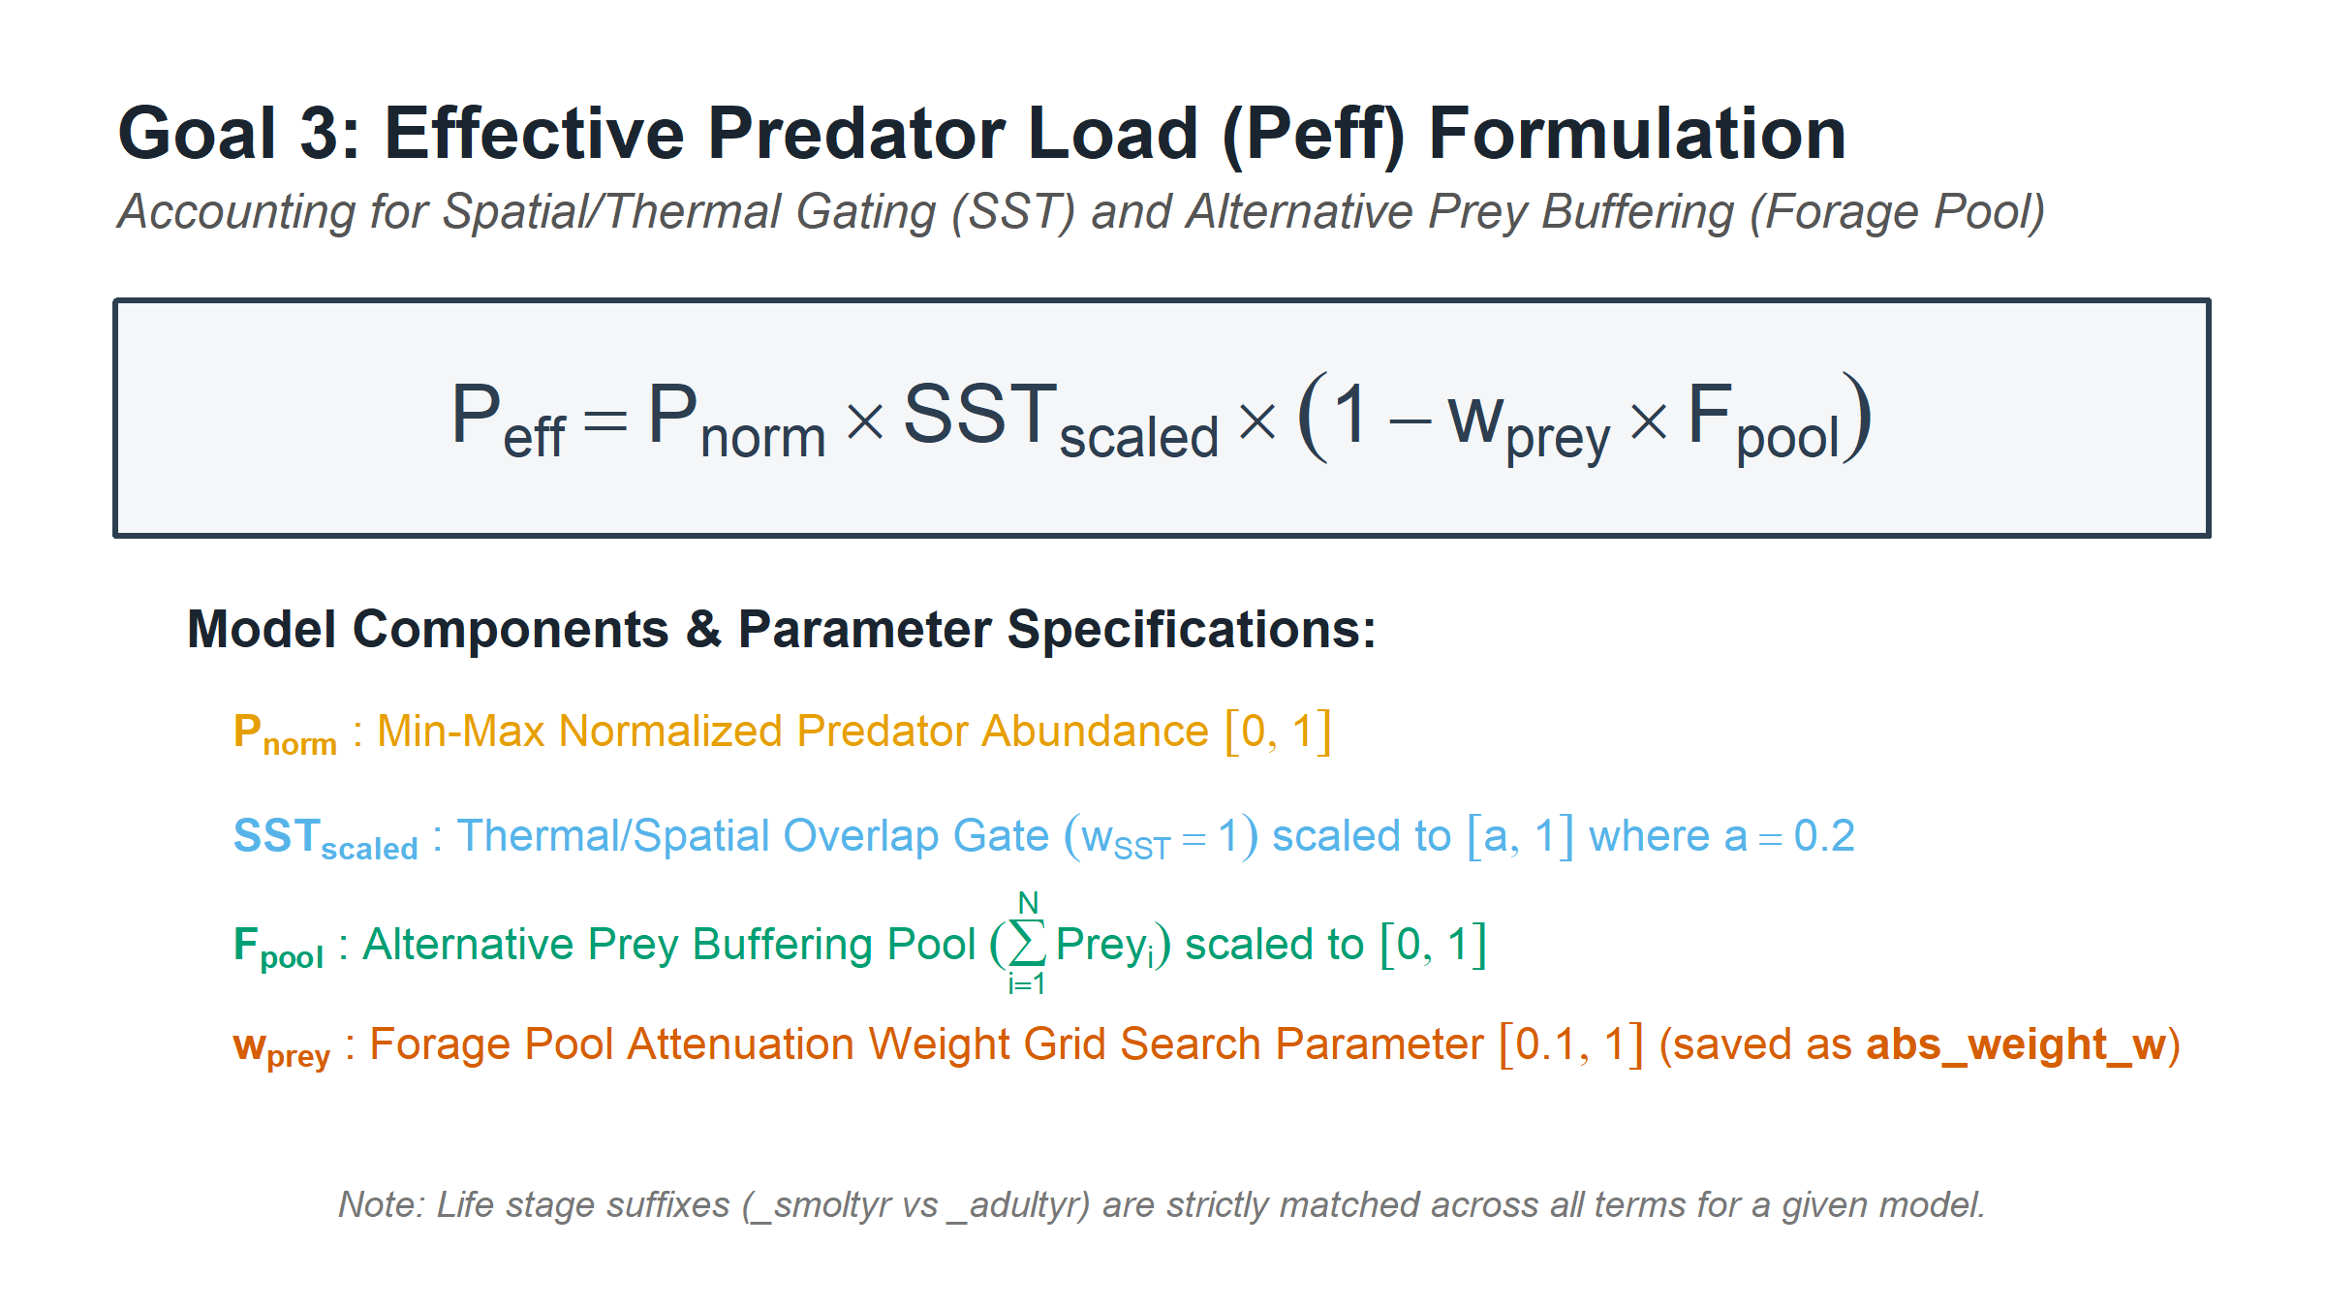
Predator weighting function
predator | abs_variant_type | abs_weight_w
X10_harbour_seal_DFO_Coastwide_smoltyr | Joint SST + 1 AltPrey | 0.5
X15_DFA_sleeperSharkBSAI_predAK_smoltyr | Joint SST + 1 AltPrey | 1
X15_sablefishAK_biomass4plus_smoltyr | Joint SST + 1 AltPrey | 1
X15_sablefishAK_biomass3plus_smoltyr | Joint SST + 2 AltPrey | 1
X10_harbour_seal_DFO_WCVI_smoltyr | AltPrey Only (2 Prey) | 1
X15_pollockGOA_SSB_lag1_smoltyr | AltPrey Only (1 Prey) | 0.8
X15_DFA_halibutBiomassAge8plus_predAK_adultyr | Joint SST + 1 AltPrey | 0.6
X11_ssl_seak_pup_pred_smoltyr | Joint SST + 2 AltPrey | 1
X15_pollockGOA_SSB_smoltyr | AltPrey Only (1 Prey) | 0.7
X15_salmonSharkGoA_predAK_smoltyr | Joint SST + 2 AltPrey | 1

Slide 18
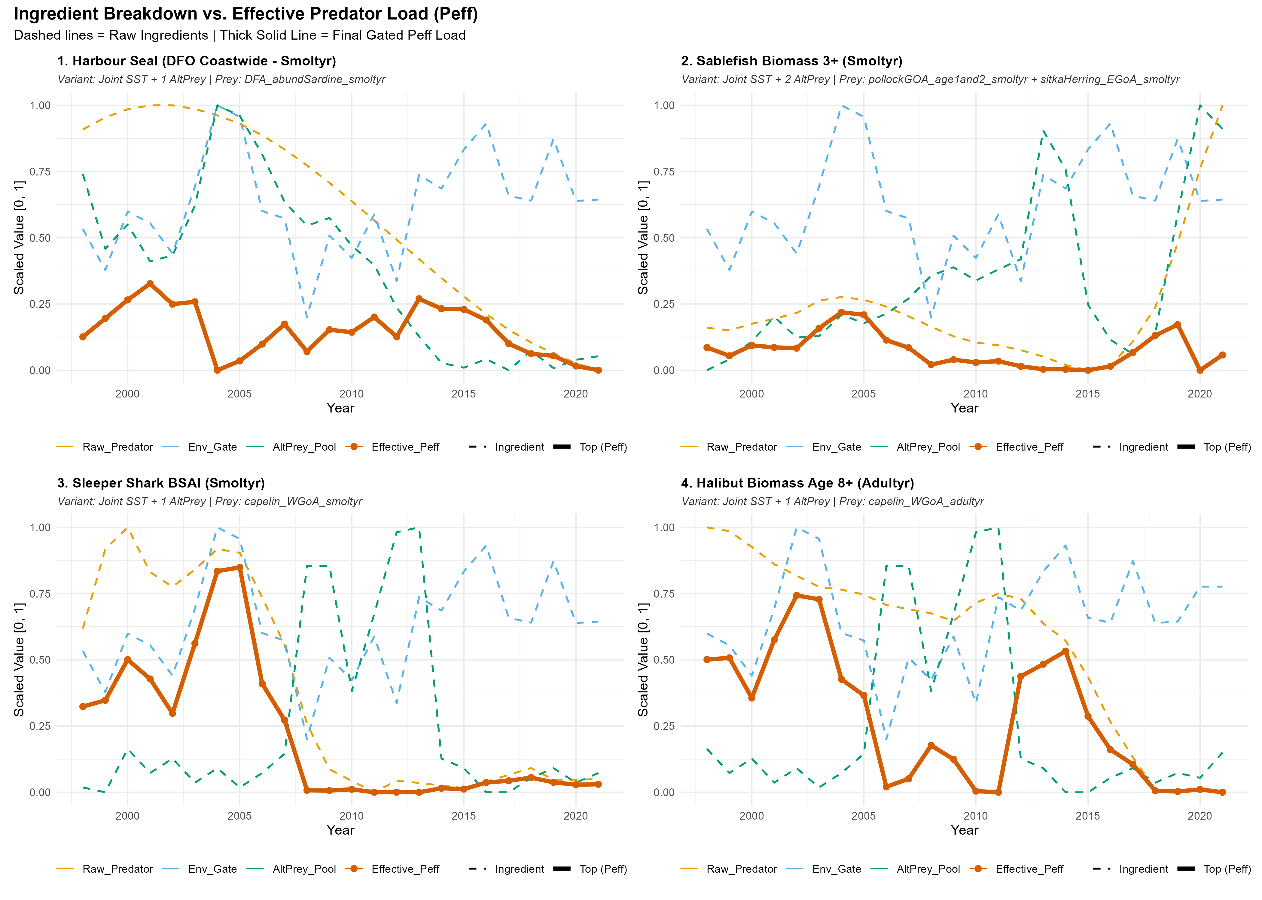

Slide 21
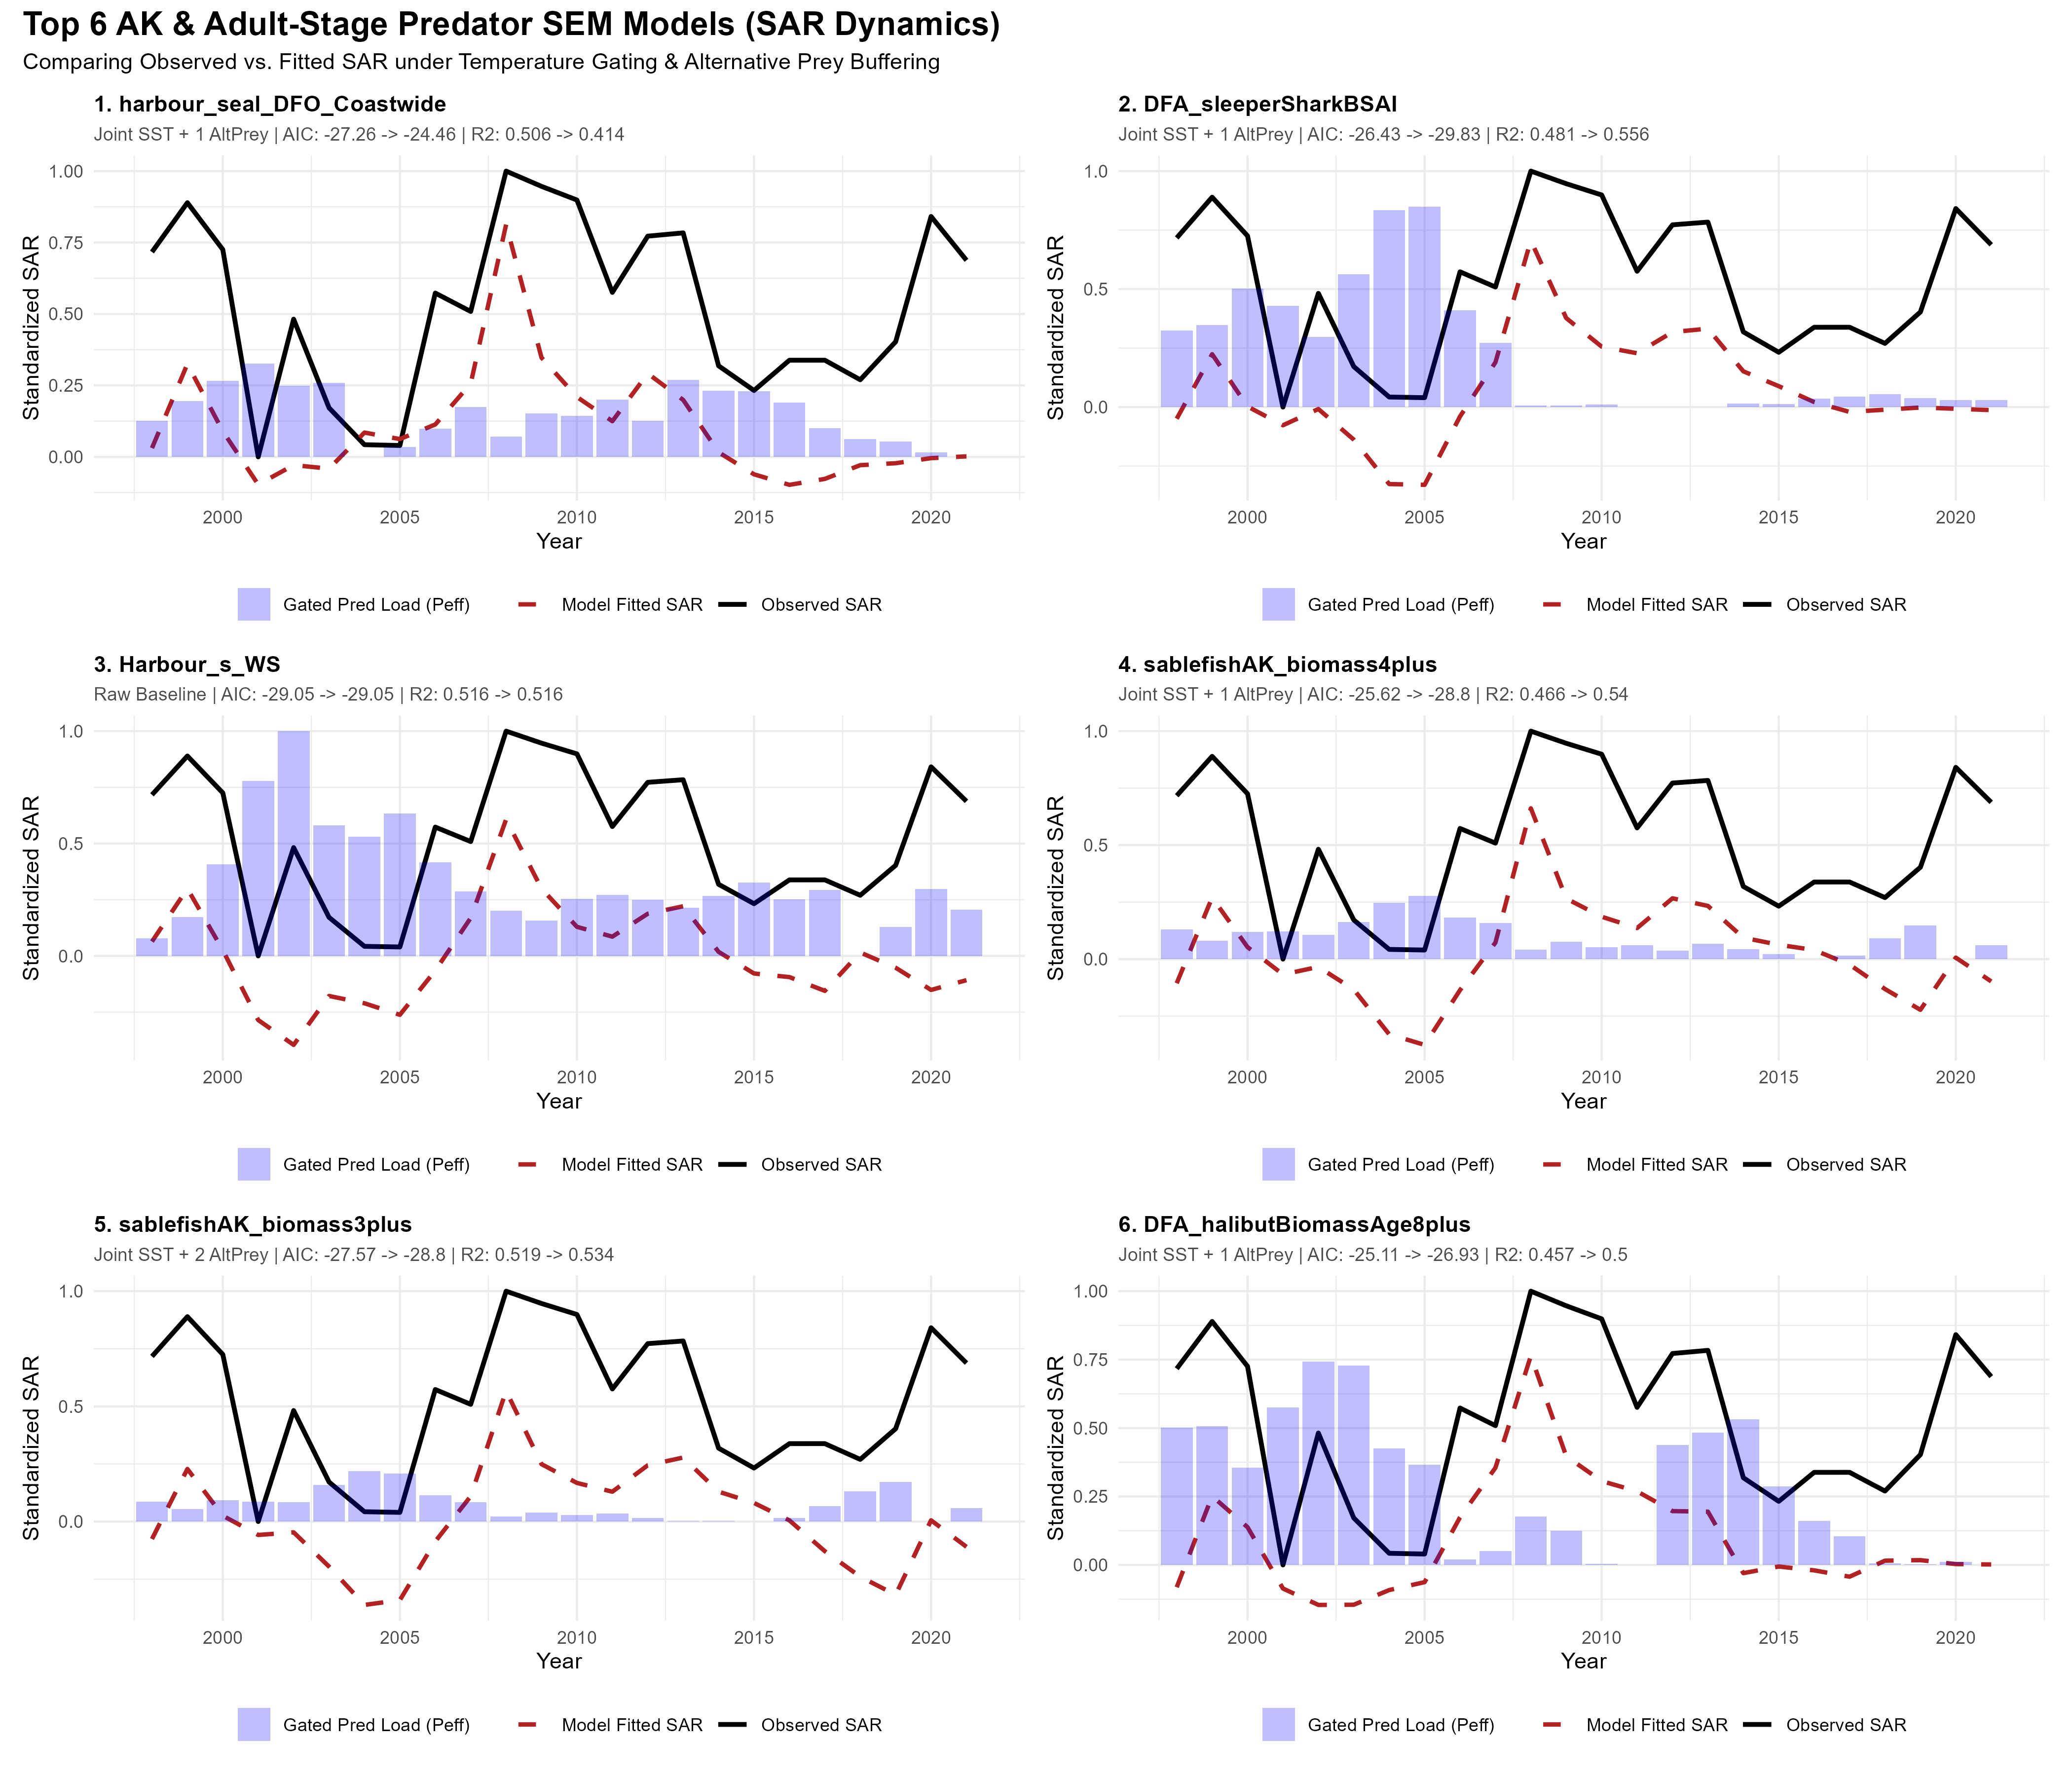

Slide 22
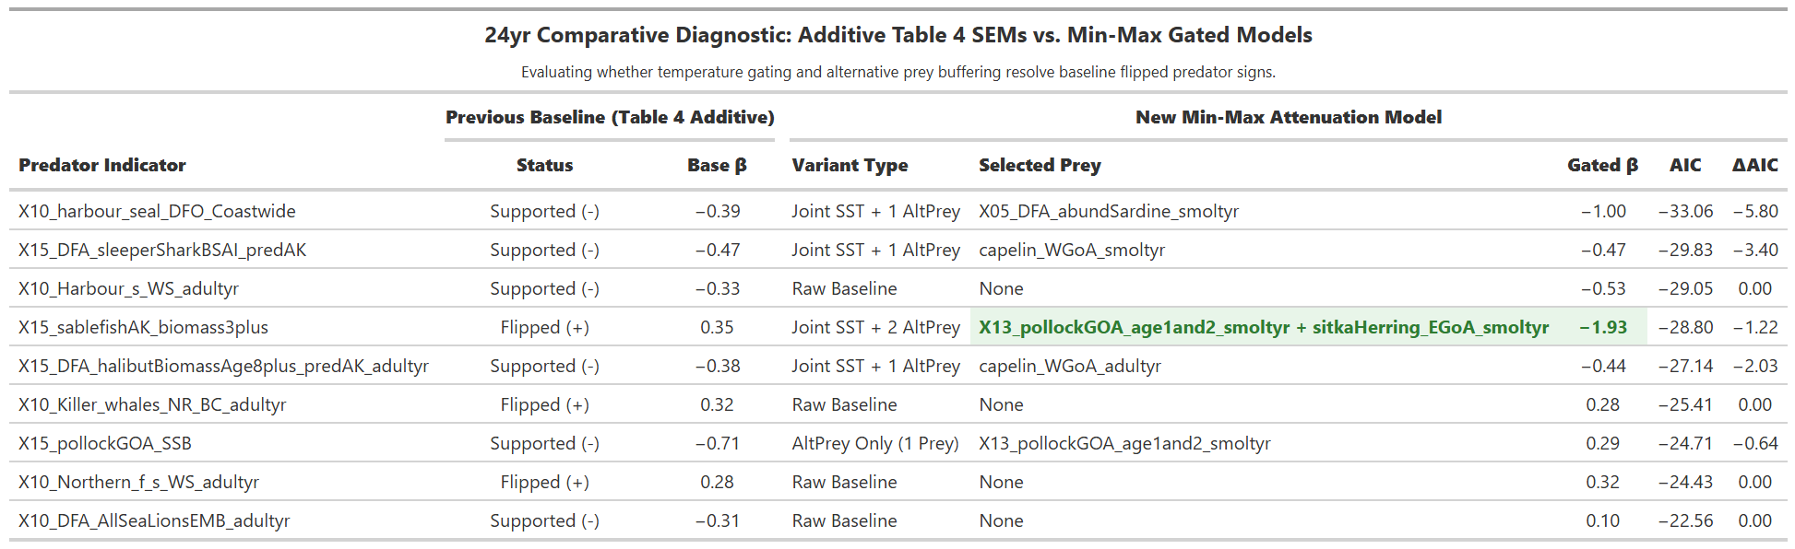
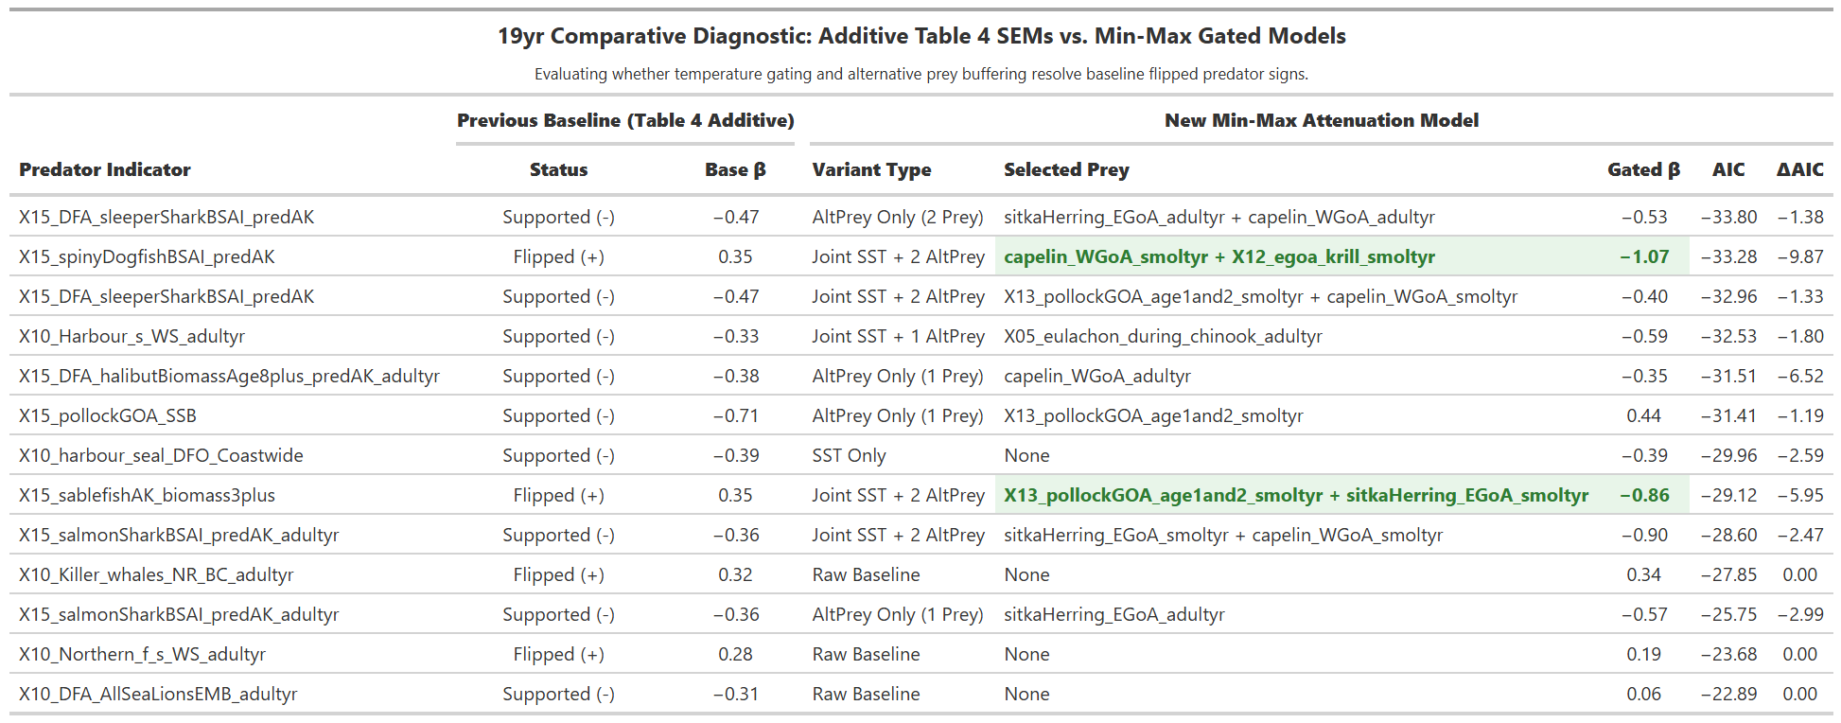

Slide 23
CONCLUSIONS
BENEFITS OF REGIONAL SURVEYS
Allows characterization of WA coast, WCVI, BC coast, and AK species interactions
Improved “limiting factor” identification, despite regional correlations
DFAs often combine data from different regions
that were positively and negatively correlated – more questions!!!
PREDATORS AS DRIVER OR PROXY?
  Experiments needed to tell, but both direct effects and modulated impacts were consistent with the data for a number of predators
  DFAs useful for dimension reduction here, but next step is traditional SEM – Eve!!!
  AK predation effects could explain much of the unexplained variation in survival

Slide 24
Thank you, questions?
acknowledgements

Slide 29
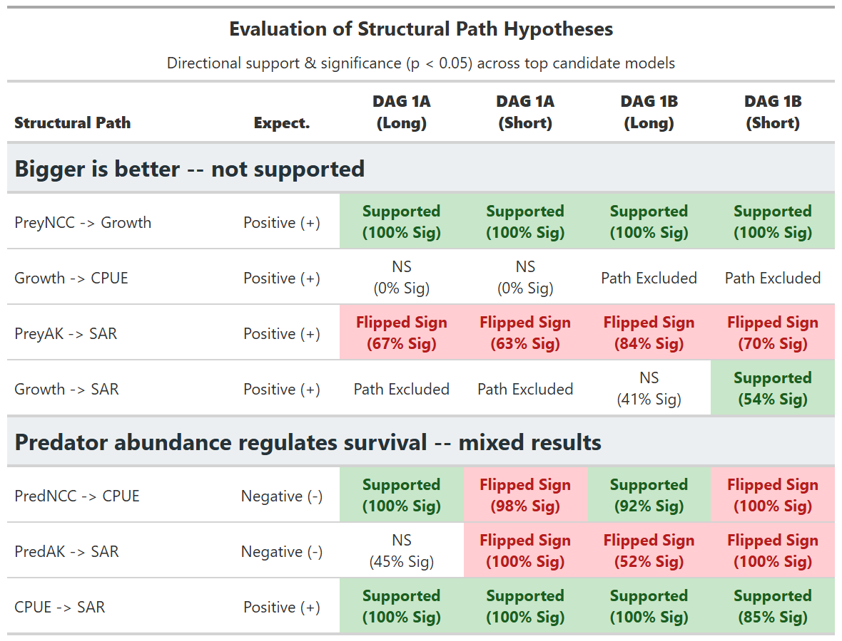
Hypotheses 1 & 2 not supported
Prey fields drive growth, but
better growth/productivity
does not increase survival
Some predators were negatively
correlated with survival (as expected)
But other predators were proxies
for something else
(opposite sign from that expected)

Slide 30
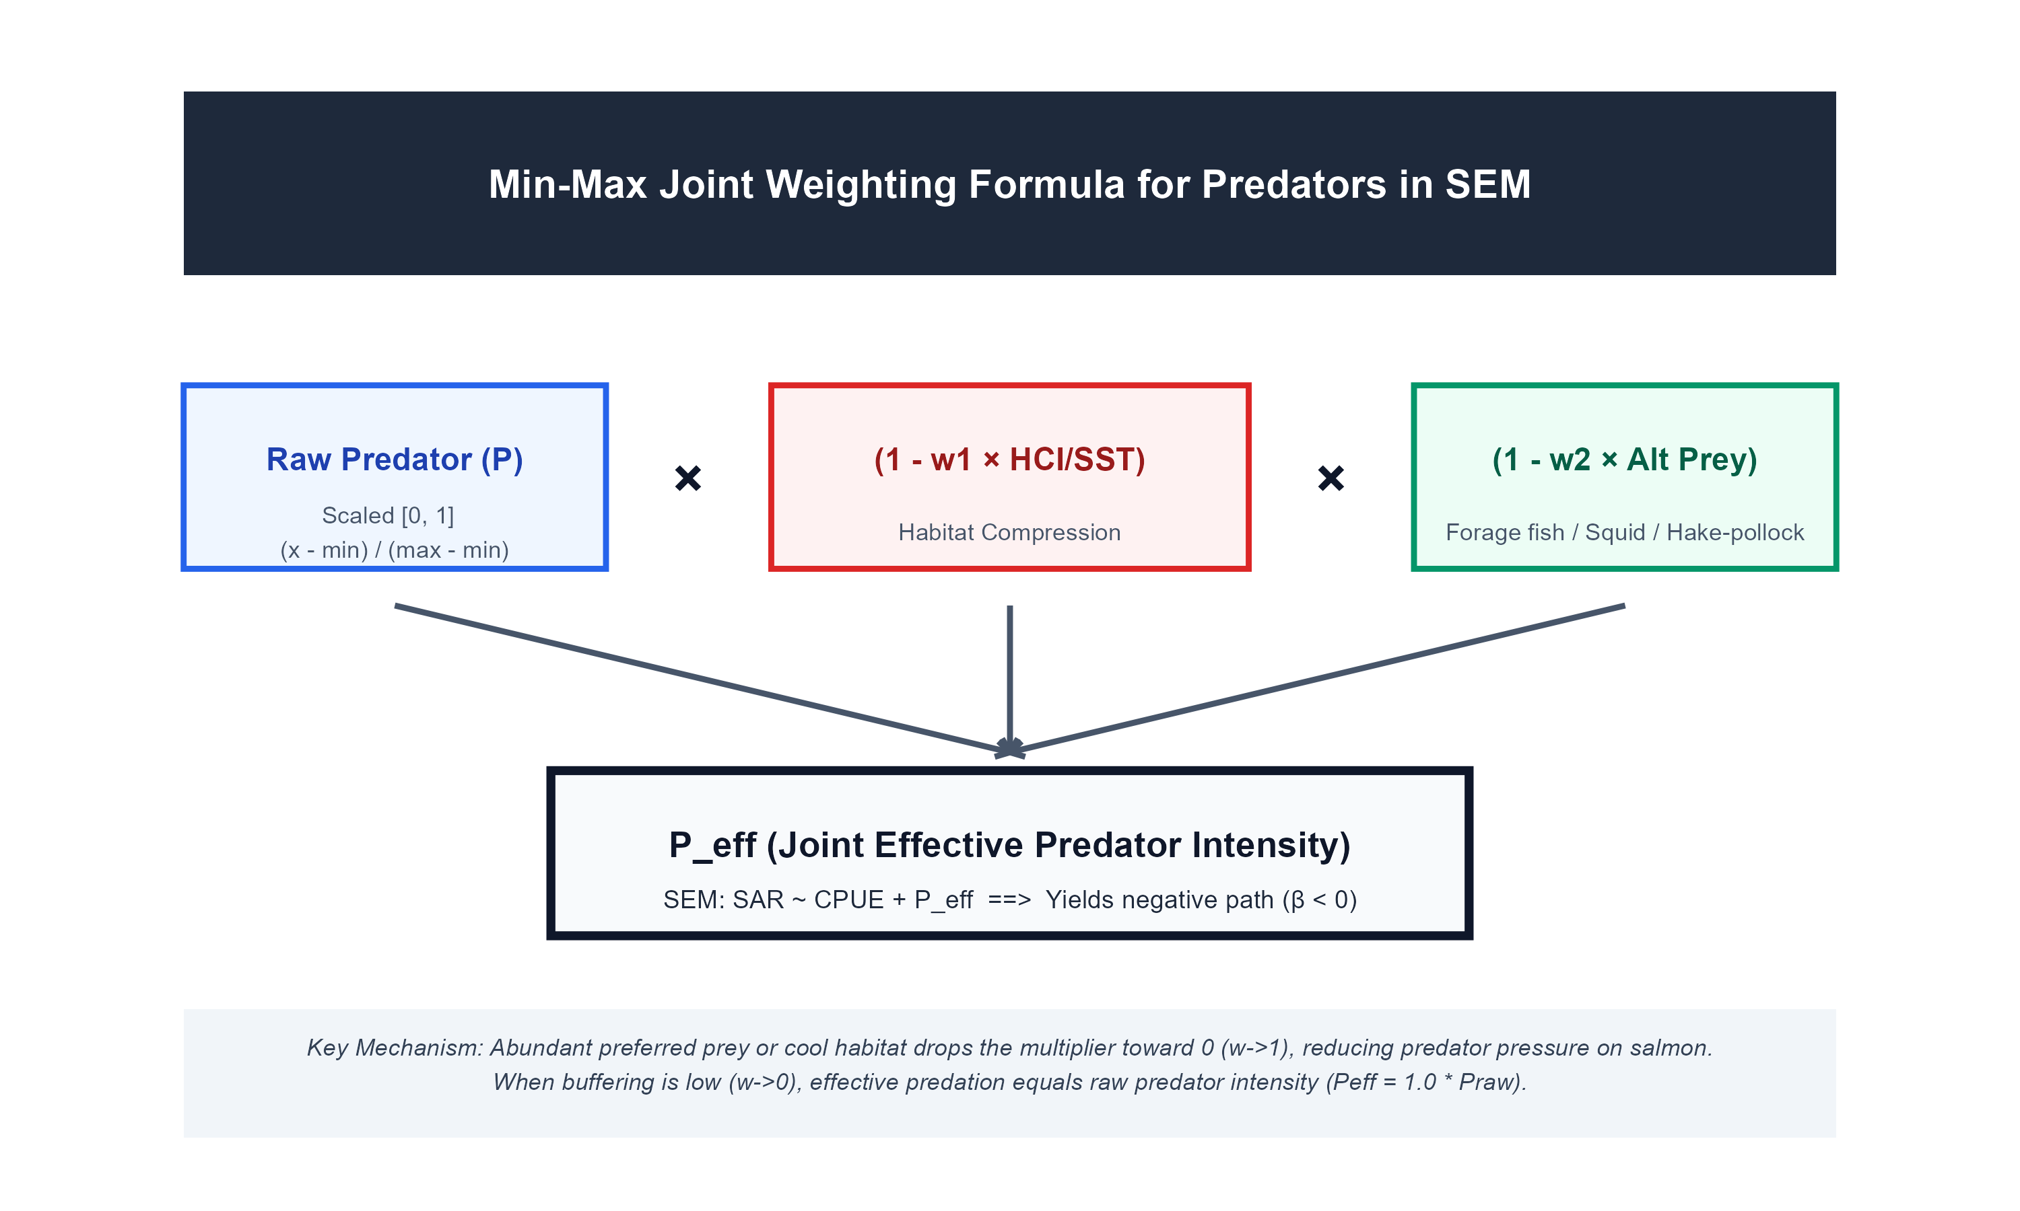
Hypothesis 3: SST or alternate prey control predator impact
Prey fields drive growth, but
better growth/productivity
does not increase survival
Some predators were negatively
correlated with survival (as expected)
But other predators were proxies
for something else
(opposite sign from that expected)

Slide 31
Digraphs
(path models) tested

Slide 32
Ocean temperature does a very good job predicting SAR
Will these trends continue, driving many pops extinct?
Is there any management action that would improve marine survival?
Crozier, et al (2021). "Climate change threatens Chinook salmon throughout their life cycle." Communications Biology 4: 222. https://doi.org/210.1038/s42003-42021-01734-w
Notes:
The problem with that is that if the trends continue, these populations are sunk.
In order to answer these questions, we need a more mechanistic understanding of marine mortality

Slide 33
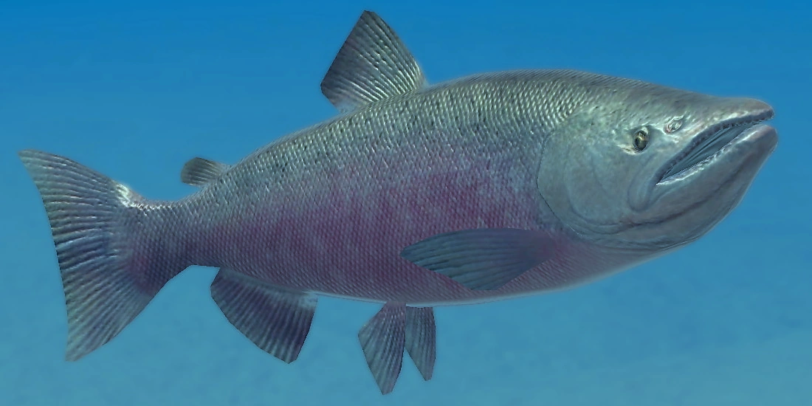
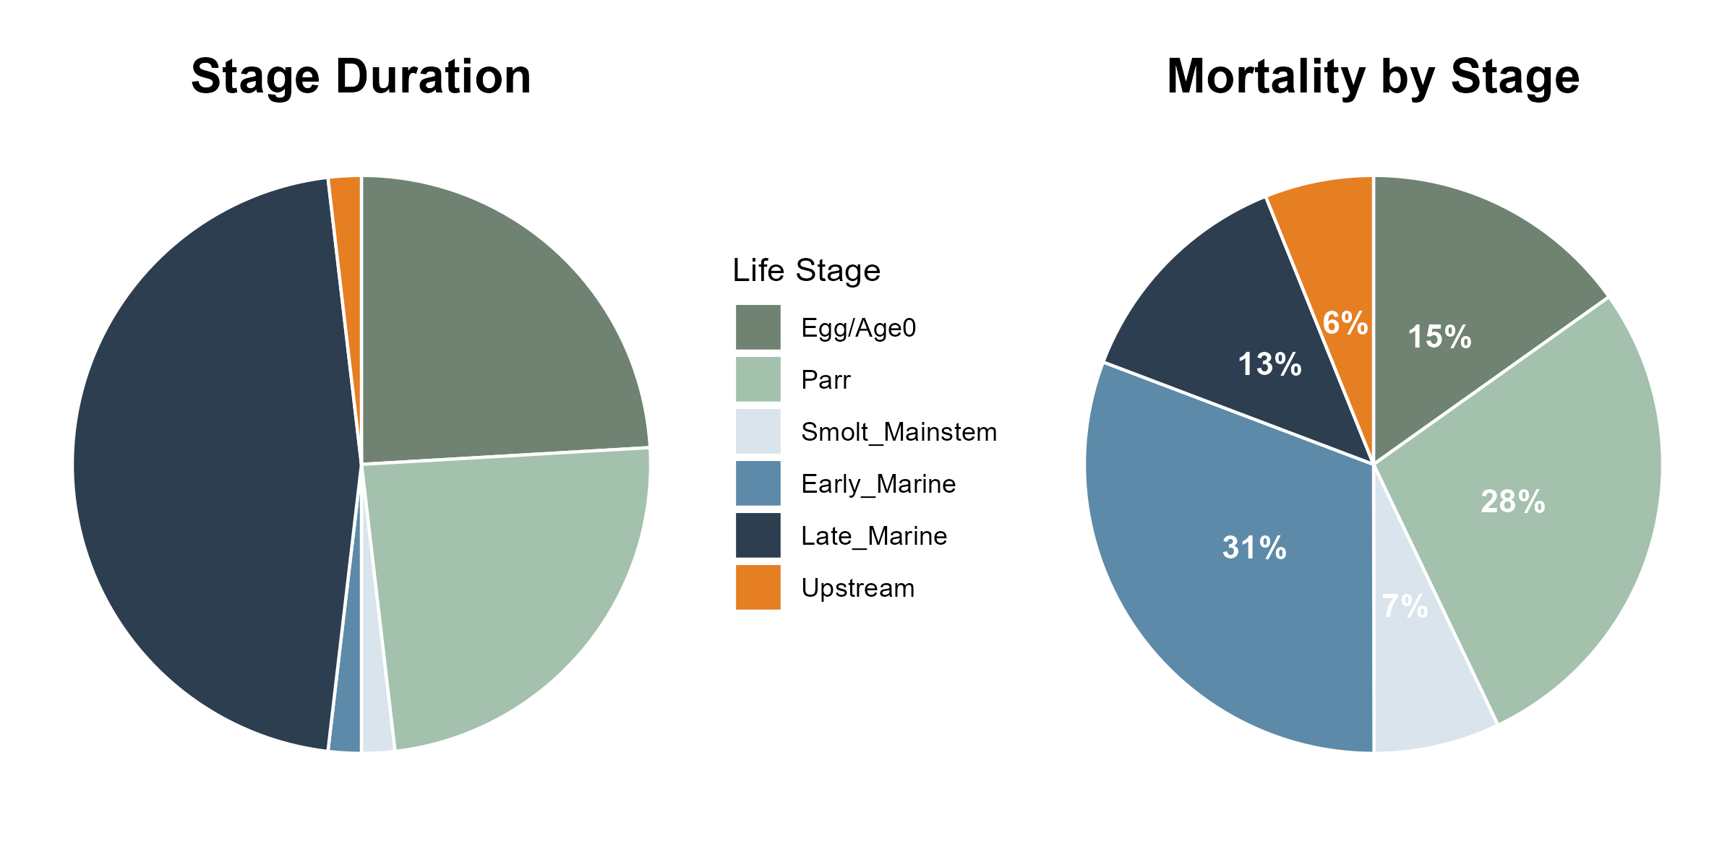
Spring Chinook spend ~ half their lives in the ocean
4 weeks
1 year
2 years
1 year
4 weeks
Photo: https://endlessocean.fandom.com/wiki/Chinook_Salmon
Notes:
The reason I’m working on this project is that compared to freshwater, we know very little about the actual mechanisms that determine survival in the ocean and what could be done to reduce that mortality

Slide 34
31% of life time mortality occurs during
2% of their life cycle in early-ocean stage
4 weeks
1 year
2 years
1 year
4 weeks
Notes:
Since they spend half their lives there, you expect about half of all mortality to occur there.
And it does. If you add LGR smolt to Bon adult total mortality, it is about half of full life cycle averages.
However, the highest and most variable piece is this early marine stage

Slide 35
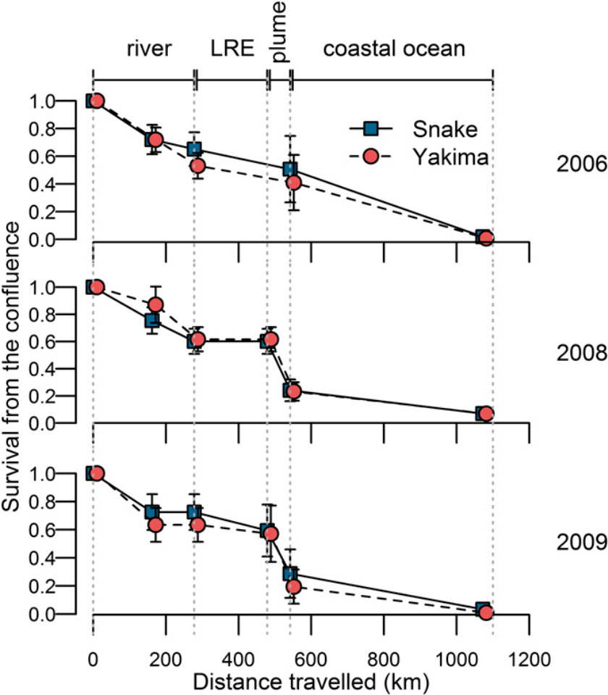
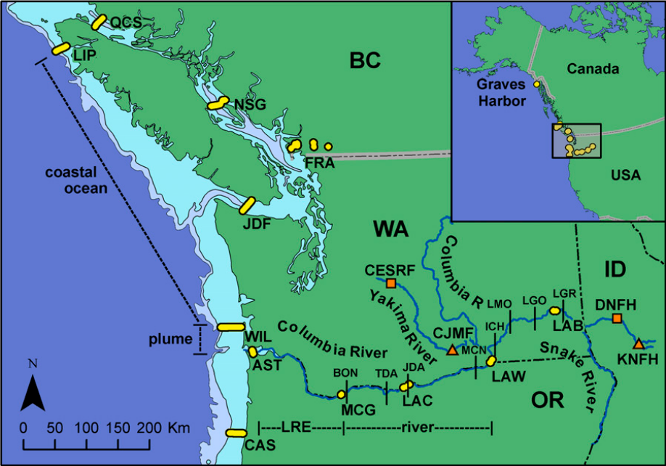
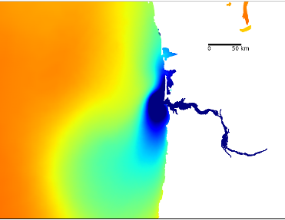
Mortality is especially high through the plume and the Northern California Current
97%
mortality
Bon -
Vanc Isl
Acoustic telemetry study of 1200 smolts:
Rechisky et al 2013
Notes:
And what we know about that is best characterized by actual experiments and acoustic tracking studies.
For example, Rechisky et al tracked smolts from lower basin and upper basin populations and found identical patterns in which the highest mortality rates occurred in the CR plume and only about 3% of smolts make it to Vancouver Island.
Nonetheless, this variability is not necessarily correlated with temperature, whereas total SAR is strongly correlated with T
1,200 smolts from Snake River and Yakima River hatcheries were tracked 1100 km together from McNary Dam to Lippy Point, with the final detection array at Graves Harbor, AK

Slide 36
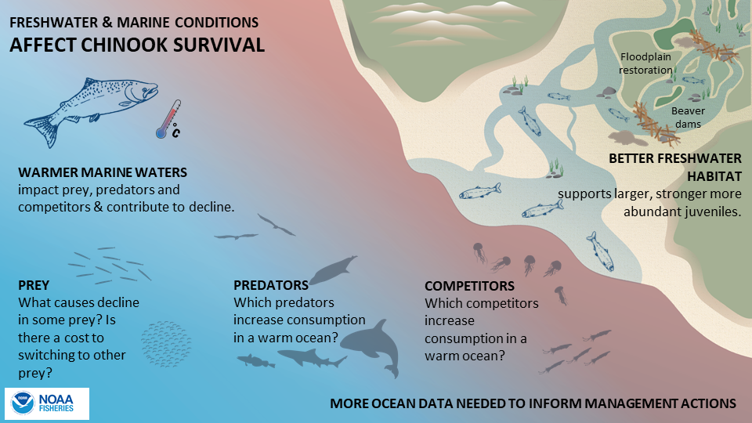
Notes:
But that question is easier to ask than answer
We cannot pinpoint a single factor that causes any of those responses
The ocean always has more food and more optimal temperatures than FW
So it is some more complex feature of the ocean community that changes with temperature
In order to understand what’s
So what’s going on?
Alternative hypotheses:
Growth effects
Better growth leads to younger age at return (plastic response)
But this does not predict fewer salmon returning (should be more)
Mortality pressure (predation or fishing)
Higher mortality in older fish
Higher mortality could occur at any ocean age
Very poor growth
Attraction of predators (e.g, hatchery fish releases, other salmon, forage fish)
Freshwater conditions
Salmon are less fit coming out of freshwater

Slide 37
Modeling goals
Step 1: Exploratory SEM (structural equation modeling )
    Variable Reduction: Rank-order indices to find the most robust predictors
    Signal Detection: Identify trophic pathways consistent with salmon survival
    Scientific Rigor: Ground all selections in a priori ecological theory
Step 2: Confirmatory SEM
    Latent Variables: Group similar indices into functional clusters (CFA)
    Structural Paths: Test and refine hypothesized mechanistic regressions
    Model Validation: Statistically verify the strength of ecosystem links

Slide 38
Data sources
NCC: Newport Hydrographic Line, Juvenile Salmon Ocean and Ecosystem; Coastal Pelagic; Joint US-CA Hake Acoustic Trawl; West Coast Bottom Trawl; Seabird Colony Monitoring Program; Westport Bird and Mammal Survey
WCVI (DFO): Zooplankton Monitoring Program, La Perouse Bank, Line P Monitoring Program, Integrated Pelagic Ecosystem, Bottom Trawl, Seabirds at Sea, Seabird Colony Monitoring Program, Cetacean Research Program
AK: Plankton and Larval; Bottom Trawl (GOA, Aleutian Islands); Coordinated Seabird Studies; Marine Mammal
SEM Node
 | Abundance | Growth | SAR | PreyNCC | PredNCC | PreyAK | PredAK
Salmon | 2 | 5 | 2
Plankton |  |  |  | 10 |  | 9
Bird Diet |  |  |  | 10 |  | 6
Jellyfish |  |  |  | 4
Squid |  |  |  | 1
Fish |  |  |  | 17 | 29 | 7 | 3
Bird |  |  |  | 5 | 36 | 4
Mammal |  |  |  |  | 10
Trophic groups
3
Count of raw time series in each bin
Prior to dimension reduction
Notes:
2 uses of SEM – exploratory and confirmatory
Phase 1: Exploratory Analysis
Goal: Variable reduction and rank ordering.
Process: You are using Exploratory Path Analysis (since you have no latent variables yet). You are "letting the data speak" to identify which specific NCC and Alaskan indicators have the strongest relationships with salmon survival.
Presentation Terminology: You might call this the Model Generation phase or Specification Search. You are identifying the "drivers" and pruning the "noise" to find a Parsimonious (simplest effective) set of indicators.
Phase 2: Confirmatory Analysis
Goal: Testing a "longer" structural model, likely with Latent Variables, to see if it holds up against standard statistical criteria.
Process: This is Confirmatory Factor Analysis (CFA) (for the measurement part) and Structural Equation Modeling (SEM) (for the structural paths). Here, you aren't just looking for what's important; you are testing a specific hypothesis about how those variables work together (e.g., "Alaskan climate indices represent a single latent 'Northern Environment' factor").
Presentation Terminology: This is the Model Validation or Hypothesis Testing phase. You are comparing Competing Models to see which one best fits the observed covariance in your data.

Slide 39
Notes:
My Approach – use the correlations explicitly
Interview experts to ID data
Assemble over 300 relevant time series
Assign functional groups
Simulate SEM modeling process to identify a “fair test” approach – std # of parameters
Collapse potential latent variables into DFAs
Conduct variable selection (aic) on 6 model structures using path analysis
Explore latent relationships on a reduced landscape
Start w/ a few spp
Add until animate the whole food web
Icons/spp vs ecosystem food web

Slide 40
Question 1
Do better growth conditions in the ocean lead to higher survival?
NO (dAIC >2)
H1
H2
PreyNCC
Marine Growth Rate
(IGF + stomach fullness
or fork length)
Growth
PreyNCC
NS
NS
PreyAK
Early Marine Survival
(cpue June JSOES survey +
sdmTMB modeled abundance)
SAR
PredatorsNCC
***
PredatorsAK
***
PreyAK
Smolt to Adult Return
(BON-BON, pittagged SR+UC)
Early Marine Survival
PredatorsNCC
PredatorsAK
Notes:
Our ultimate goal is to predict SAR from biological indices rather than climatic indices. And we want to do that by partitioning total marine survival into early and later stages.
All components of the model are smoothed using either a DFA to combine potential latent variables or a MARSS model for single variables. This is part of the “fair test” requirement for this phase
We tested this hypothesis by comparing two model structures.
In the first, a number of different possible indices of growth were modeled as predictors of early marine survival, measured using both the cpue directly from the JSOES survey as well as a modeled abundance from a spatiotemporal model that accounts for slight variations from year to year in the survey
Our response variable is the combined SAR
Here are 2 structures we explored – growth -> abundance -> SAR
Growth->SAR & Abund -> SAR
The idea was to compare model structures by aic
But also to identify the best predictors a
Size to cpue
Size selective predation, gape-limited predation
Prey-switching of predator – predators eating more other prey (buffer)

Slide 41
Question 2
Is SAR better predicted with info from BC/AK and not just OR/WA?
YES
BC: amphipods,
euphausiids, and mysids,
AK: auklet reproductive success
PreyAK
R²= 0.81
AIC=33
Early Marine Survival
SAR
R²= 0.71
AIC=42
Predators on Adults
NCC: Mammals
R²= 0.83
AIC=31
Notes:
Our ultimate goal is to predict SAR from biological indices rather than climatic indices. And we want to do that by partitioning total marine survival into early and later stages.
All components of the model are smoothed using either a DFA to combine potential latent variables or a MARSS model for single variables. This is part of the “fair test” requirement for this phase
We tested this hypothesis by comparing two model structures.
In the first, a number of different possible indices of growth were modeled as predictors of early marine survival, measured using both the cpue directly from the JSOES survey as well as a modeled abundance from a spatiotemporal model that accounts for slight variations from year to year in the survey
Our response variable is the combined SAR
Here are 2 structures we explored – growth -> abundance -> SAR
Growth->SAR & Abund -> SAR
The idea was to compare model structures by aic
But also to identify the best predictors a
Size to cpue
Size selective predation, gape-limited predation
Prey-switching of predator – predators eating more other prey (buffer)

Slide 43
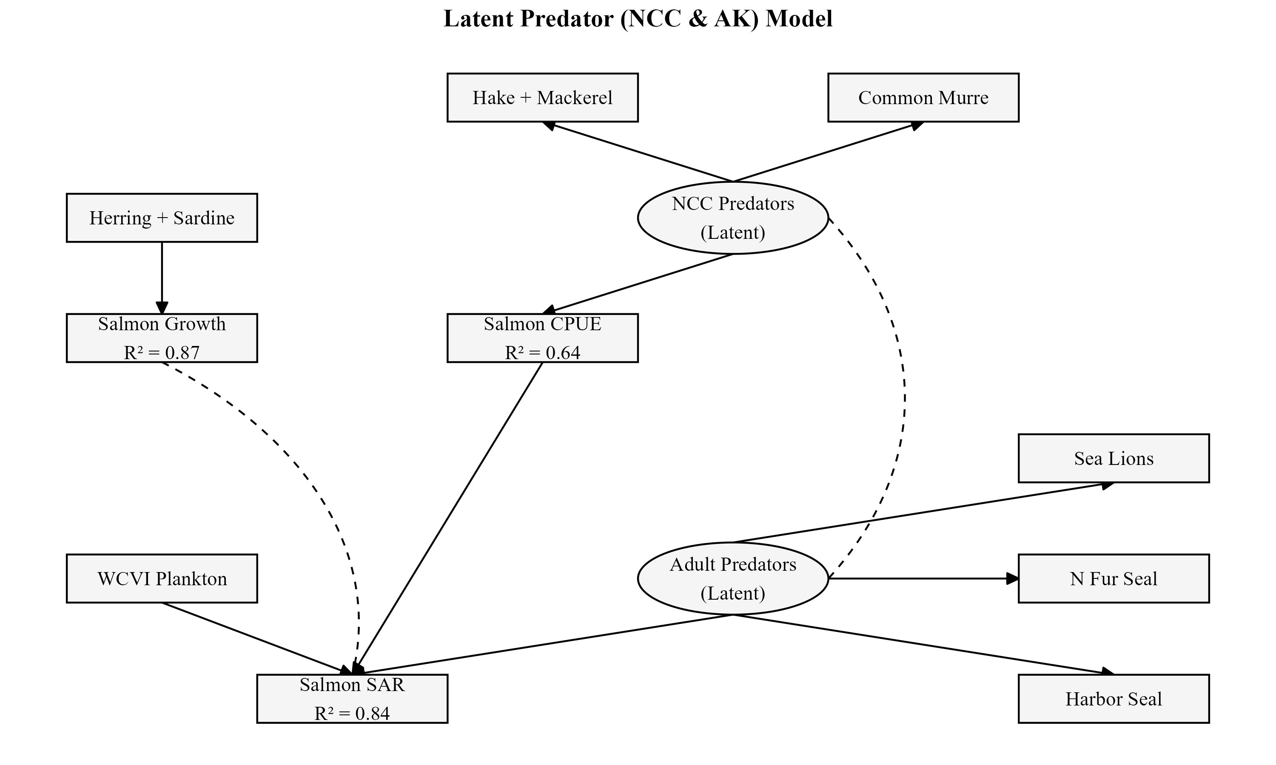
To come…
Notes:
Mg – understanding, better predictions, or manage

Slide 44
Conclusions
Piscivorous Fish Indices are Helpful
Hake and Mackerel abundance are the strongest predictors of early marine survival
The Growth Paradox
While productivity helped predict SAR,
growth itself was not a primary driver of SAR
BC and AK data help
We can improve SAR predictions using more ecological data (R² = 0.81-0.83)
Getty images
Photo: NOAA
Notes:
1. What We Found: The "Top Winners" Identified
Distilled Complexity: From 160+ biological indicators, we identified a parsimonious set of top-performing predictors for Smolt-to-Adult Return (SAR).
Key Indicators: Latent variables reflecting herring and sardine abundance predicted salmon growth, while latent variables reflecting hake and mackerel (pacific and jack mackerel) were highly informative for early marine survival. Zooplankton prey in Canada and seabird reproductive success in Alaska emerged as the most robust biological signals that improved estimates of adult salmon survival.
Synergistic Drivers: Survival is driven by a balance of growth potential (prey availability) and predation buffering.
2. What We Solved: Geographic Scope & Predictive Power
Beyond Local Metrics: Local survival is dictated by broad-scale oceanographic conditions: accuracy increased significantly when incorporating BC and Alaska productivity metrics.
High Model Performance: Integrating these expanded geographic indices into the SEM achieved an R^2 of 0.81–0.83, validating the model’s reach.
3. The Hand-off: Mechanistic Links
We have identified what is driving survival; the next talk defines how the physics dictates these outcomes:

Slide 45
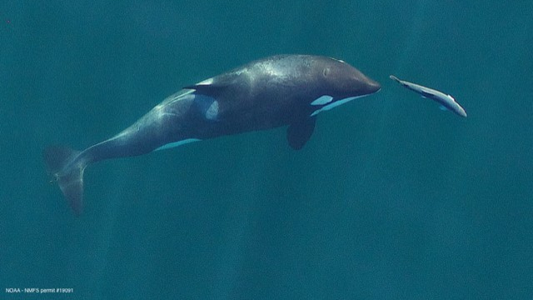


Thank you!
Questions?
NOAA AND DFO SURVEY TEAMS
PIT TAGGERS of all Spring Chinook Salmon
FISH COUNTERS at all dams
PTAGIS and DART (Columbia Basin Research) for data access

Slide 46
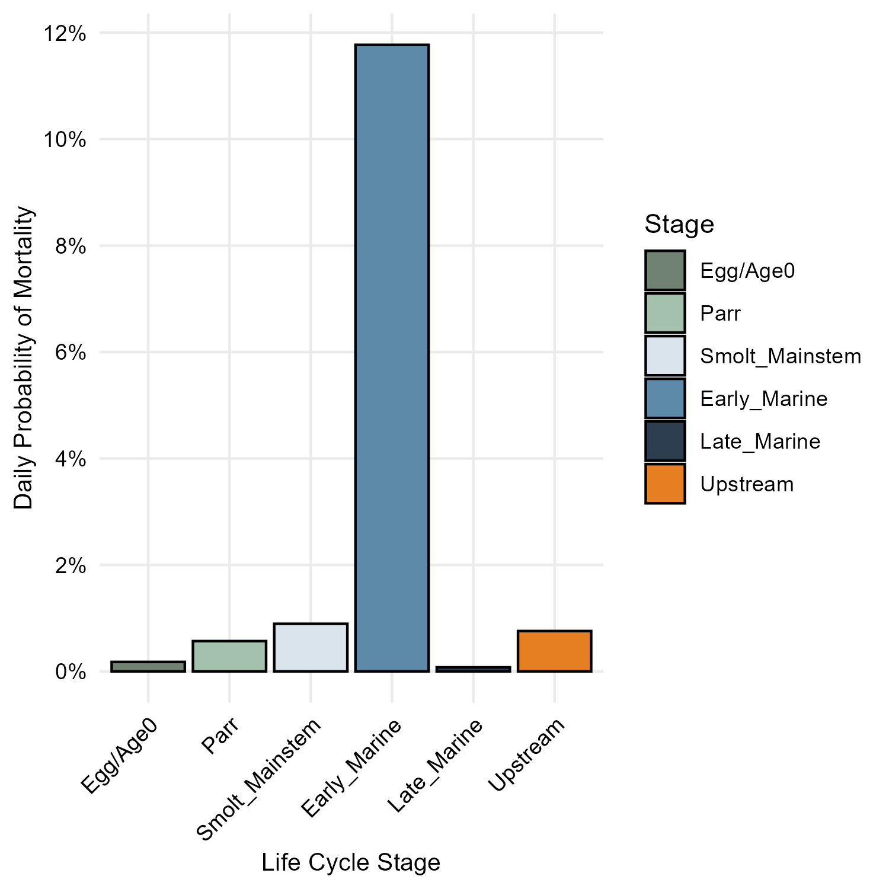
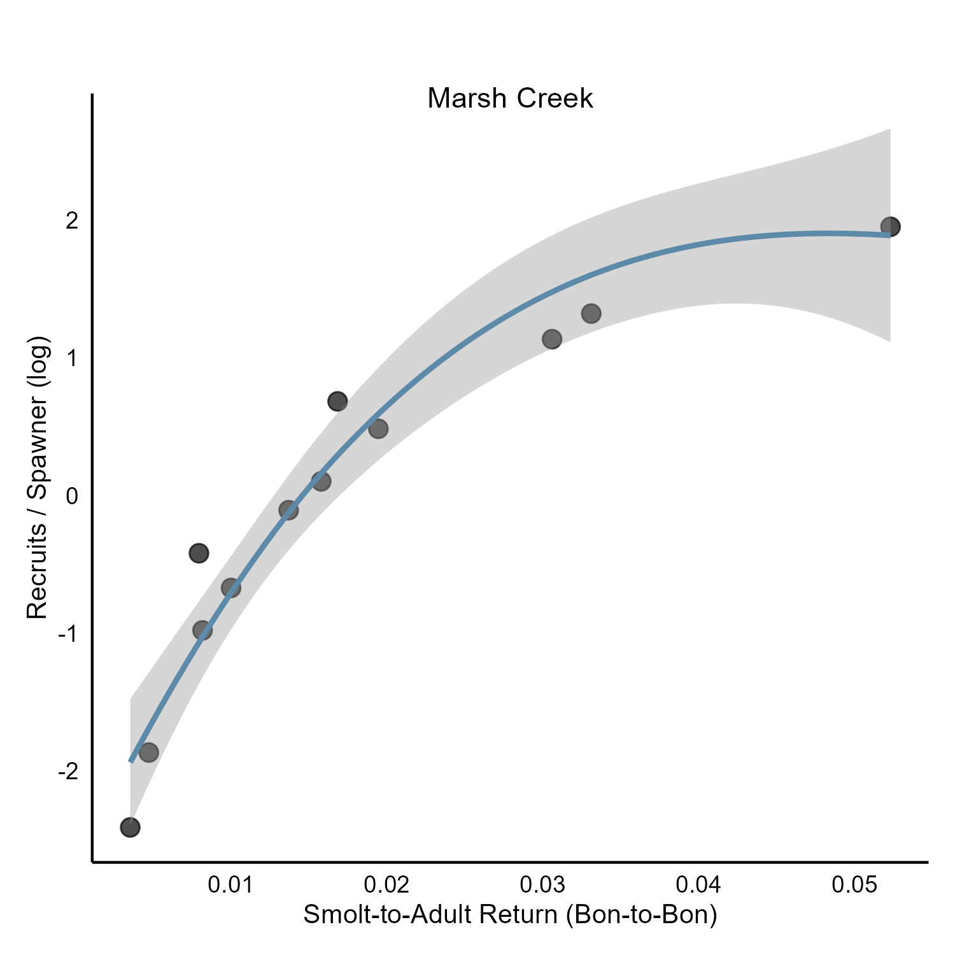
The early marine stage is the most dangerous per day and the most predictive of population productivity
Daily probability of mortality
Recruits/spawner ~ ocean survival

